Slide 1

Chapter 3
Transport Layer
A note on the use of these PowerPoint slides:
We’re making these slides freely available to all (faculty, students, readers). They’re in PowerPoint form so you see the animations; and can add, modify, and delete slides (including this one) and slide content to suit your needs. They obviously represent a lot of work on our part. In return for use, we only ask the following:
If you use these slides (e.g., in a class) that you mention their source (after all, we’d like people to use our book!)
If you post any slides on a www site, that you note that they are adapted from (or perhaps identical to) our slides, and note our copyright of this material.
For a revision history, see the slide note for this page.
Thanks and enjoy! JFK/KWR
All material copyright 1996-2020
J.F Kurose and K.W. Ross, All Rights Reserved
Computer Networking: A Top-Down Approach
8th edition
Jim Kurose, Keith Ross
Pearson, 2020
Notes:
Version History
8.0 (April 2020)
All slides reformatted for 16:9 aspect ratio
All slides updated to 8th edition material
Use of Calibri font, rather that Gill Sans MT
Add LOTS more animation throughout
added new 8th edition material on QUIC, CUBIC, delay-based congestion control
lighter header font

Slide 2
Transport layer: overview
Our goal:
understand principles behind transport layer services:
  multiplexing, demultiplexing
  reliable data transfer
  flow control
  congestion control
learn about Internet transport layer protocols:
  UDP: connectionless transport
  TCP: connection-oriented reliable transport
  TCP congestion control

Slide 3

Transport layer: roadmap
Transport-layer services
Multiplexing and demultiplexing
Connectionless transport: UDP
Principles of reliable data transfer
Connection-oriented transport: TCP
Principles of congestion control
TCP congestion control
Evolution of transport-layer functionality
Notes:
Add:
segment structure
reliable data transfer
flow control
connection management

Slide 4
















Transport services and protocols
application
transport
network
data link
physical
provide logical communication between application processes running on different hosts
mobile network
national or global ISP
transport protocols actions in end systems:
  sender: breaks application messages into segments, passes to network layer
  receiver: reassembles segments into messages, passes to application layer
logical end-end transport
local or regional ISP
home network
content
provider
network
application
transport
network
data link
physical
datacenter
network
two transport protocols available to Internet applications
  TCP, UDP
enterprise
network
Notes:
By logical communication , we
mean that from an application’s perspective, it is as if the hosts running the processes
were directly connected; in reality, the hosts may be on opposite sides of the
planet, connected via numerous routers and a wide range of link types. Application
processes use the logical communication provided by the transport layer to send
messages to each other, free from the worry of the details of the physical infrastructure
used to carry these messages.
Let’s look at each of these three (logical communications, actions,

Slide 5

Transport vs. network layer services and protocols
household analogy:
12 kids in Ann’s house sending letters to 12 kids in Bill’s house:
hosts = houses
processes = kids
app messages = letters in envelopes
transport protocol = Ann and Bill who demux to in-house siblings
network-layer protocol = postal service

Slide 6
Transport vs. network layer services and protocols
network layer: logical communication between hosts
transport layer: logical communication between processes
  relies on, enhances, network layer services
household analogy:
12 kids in Ann’s house sending letters to 12 kids in Bill’s house:
hosts = houses
processes = kids
app messages = letters in envelopes
transport protocol = Ann and Bill who demux to in-house siblings
network-layer protocol = postal service

Slide 7
Transport Layer Actions
Sender:
application
application
is passed an application-layer message
app. msg
determines segment header fields values
T_{h}
transport
app. msg
transport
T_{h}
creates segment
network (IP)
network (IP)
passes segment to IP
link
link
physical
physical

Slide 8
Transport Layer Actions
Receiver:
application
receives segment from IP
application
checks header values
transport
transport
app. msg
extracts application-layer message
network (IP)
network (IP)
demultiplexes message up to application via socket
link
link
physical
physical
app. msg
T_{h}

Slide 9
Two principal Internet transport protocols
application
transport
network
data link
physical
TCP: Transmission Control Protocol
  reliable, in-order delivery
  congestion control
  flow control
  connection setup
UDP: User Datagram Protocol
  unreliable, unordered delivery
  no-frills extension of “best-effort” IP
services not available:
  delay guarantees
  bandwidth guarantees
mobile network
national or global ISP
logical end-end transport
local or regional ISP
home network
content
provider
network
application
transport
network
data link
physical
datacenter
network
enterprise
network

Slide 10
Chapter 3: roadmap
Transport-layer services
Multiplexing and demultiplexing
Connectionless transport: UDP
Principles of reliable data transfer
Connection-oriented transport: TCP
Principles of congestion control
TCP congestion control
Evolution of transport-layer functionality

Slide 11





HTTP server
client
application
application
HTTP msg
transport
transport
network
transport
network
link
network
link
physical
link
physical
physical

Slide 12
HTTP server
client
application
application
HTTP msg
transport
H_{t}
HTTP msg
transport
network
transport
network
link
network
link
physical
link
physical
physical

Slide 13
HTTP server
client
application
application
HTTP msg
transport
H_{t}
HTTP msg
H_{n}
H_{t}
network
transport
HTTP msg
transport
network
link
network
link
physical
link
physical
physical

Slide 14
HTTP server
client
application
application
transport
transport
network
transport
network
link
network
link
physical
link
physical
physical
H_{n}
H_{t}
HTTP msg

Slide 15

HTTP server
client₁
client₂
application
P-client₁
P-client₂
application
transport
transport
network
transport
network
link
network
link
physical
link
physical
physical

Slide 16
Multiplexing/demultiplexing
multiplexing at sender:
demultiplexing at receiver:
handle data from multiple
sockets, add transport header (later used for demultiplexing)
use header info to deliver
received segments to correct
socket
application
application
P1
P2
application
socket
P3
transport
P4
process
transport
network
transport
network
link
network
link
physical
link
physical
physical

Slide 17
How demultiplexing works
host receives IP datagrams
  each datagram has source IP address, destination IP address
  each datagram carries one transport-layer segment
  each segment has source, destination port number
host uses IP addresses & port numbers to direct segment to appropriate socket
32 bits
source port #
dest port #
other header fields
application
data
(payload)
TCP/UDP segment format

Slide 18
Connectionless demultiplexing
Recall:
when creating socket, must specify host-local port #:
DatagramSocket mySocket1 = new DatagramSocket(12534);
when receiving host receives UDP segment:
  checks destination port # in segment
  directs UDP segment to socket with that port #
when creating datagram to send into UDP socket, must specify 2-tuple
  destination IP address
  destination port #
IP/UDP datagrams with same dest. port #, but different source IP addresses and/or source port numbers will be directed to same socket at receiving host
Notes:
Add:
2-tuple

Slide 19
Connectionless demultiplexing: an example
DatagramSocket serverSocket = new DatagramSocket
(6428);
DatagramSocket mySocket2 = new DatagramSocket
(9157);
DatagramSocket mySocket1 = new DatagramSocket (5775);
Application
(DNS Server)
application
P1
application
P3
P4
transport
transport
network
transport
network
link
network
link
physical
link
physical
physical
source port: 6428
dest port: 9157
source port: ?
dest port: ?
source port: 9157
dest port: 6428
source port: ?
dest port: ?
Notes:
Add:
(DNS Server)

Slide 20
Connection-oriented demultiplexing
TCP socket identified by 4-tuple:
  source IP address
  source port number
  dest IP address
  dest port number
server may support many simultaneous TCP sockets:
  each socket identified by its own 4-tuple
  each socket associated with a different connecting client
web servers have different sockets for each connecting client
  non-persistent HTTP will have different socket for each request
demux: receiver uses all four values (4-tuple) to direct segment to appropriate socket
Notes:
Add:
web servers have different sockets for each connecting client
non-persistent HTTP will have different socket for each request

Slide 21
Connection-oriented demultiplexing: example
application
application
P4
P5
P6
application
P1
P2
P3
transport
transport
network
transport
network
link
network
link
physical
link
physical
server: IP address B
physical
host: IP address A
source IP,port: B,80
dest IP,port: A,9157
host: IP address C
source IP,port: C,5775
dest IP,port: B,80
source IP,port: A,9157
dest IP, port: B,80
source IP,port: C,9157
dest IP,port: B,80
Three segments, all destined to IP address: B,
dest port: 80 are demultiplexed to different sockets

Slide 22
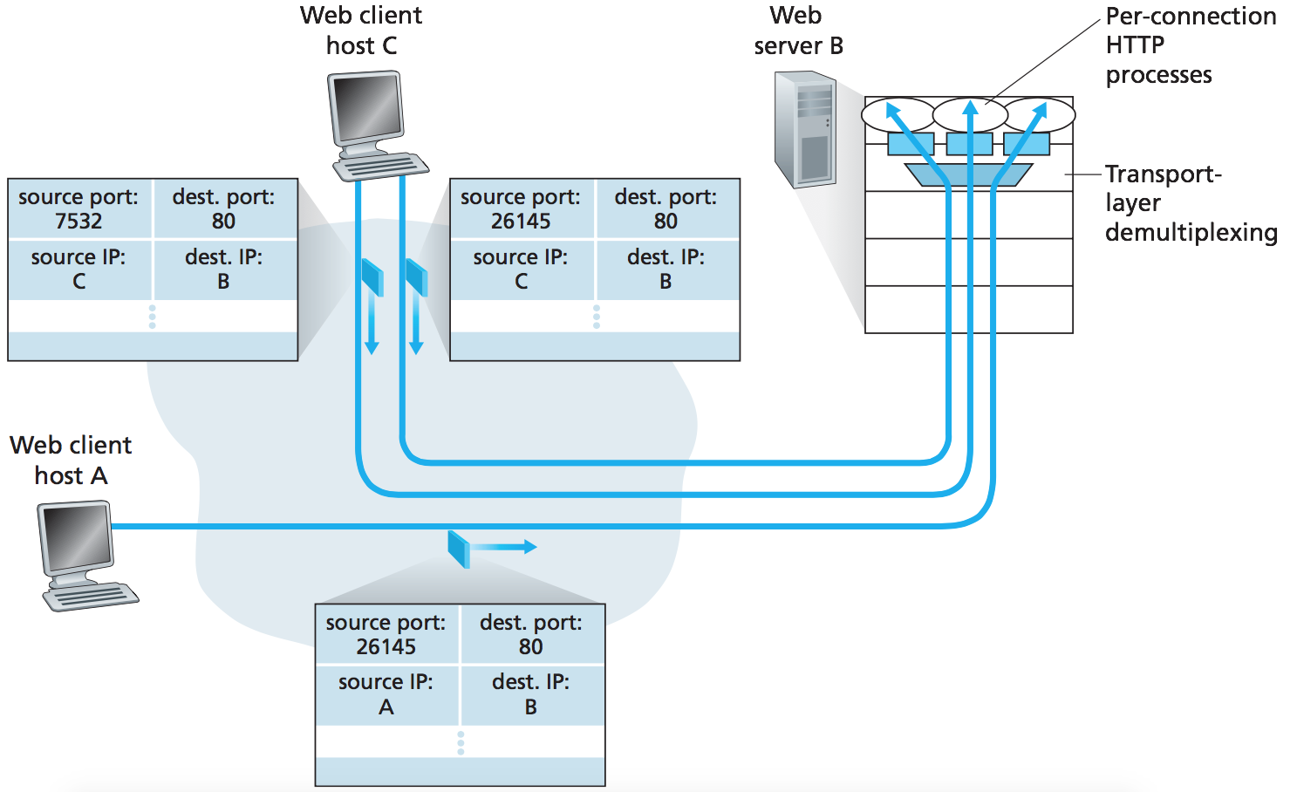
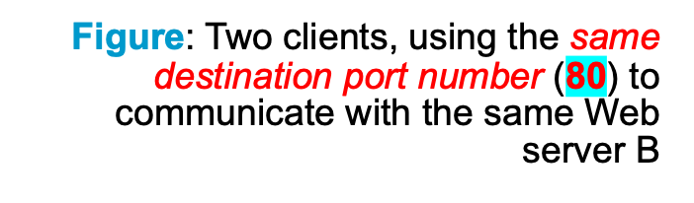
Connection-oriented demultiplexing: example
web server have different sockets for each connecting client
Port 80
HTTP session 2
HTTP session 3
HTTP session 1
Transport Layer: 3-‹#›

Slide 23
Summary
Multiplexing, demultiplexing: based on segment, datagram header field values
UDP: demultiplexing using destination port number (only)
TCP: demultiplexing using 4-tuple: source and destination IP addresses, and port numbers
Multiplexing/demultiplexing happen at all layers

Slide 24
Chapter 3: roadmap
Transport-layer services
Multiplexing and demultiplexing
Connectionless transport: UDP
Principles of reliable data transfer
Connection-oriented transport: TCP
Principles of congestion control
TCP congestion control
Evolution of transport-layer functionality

Slide 25
UDP: User Datagram Protocol
Why is there a UDP?
“no frills,” “bare bones” Internet transport protocol
“best effort” service, UDP segments may be:
  lost
  delivered out-of-order to app
no connection establishment (which can add RTT delay)
simple: no connection state at sender, receiver
small header size
no congestion control
  UDP can blast away as fast as desired!
  can function in the face of congestion
connectionless:
  no handshaking between UDP sender, receiver
  each UDP segment handled independently of others

Slide 26
UDP: User Datagram Protocol
UDP use:
  streaming multimedia apps (loss tolerant, rate sensitive)
  DNS
  SNMP
  HTTP/3
if reliable transfer needed over UDP (e.g., HTTP/3):
  add needed reliability at application layer
  add congestion control at application layer

Slide 27

UDP: User Datagram Protocol [RFC 768]
Notes:
read this RFC – it’s only 2.5 pages!

Slide 28
UDP: Transport Layer Actions
SNMP client
SNMP server
application
application
transport
(UDP)
transport
(UDP)
network (IP)
network (IP)
link
link
physical
physical

Slide 29
UDP: Transport Layer Actions
SNMP client
SNMP server
UDP sender actions:
application
application
is passed an application-layer message
SNMP msg
transport
(UDP)
transport
(UDP)
determines UDP segment header fields values
UDP_{h}
SNMP msg
UDP_{h}
creates UDP segment
network (IP)
network (IP)
passes segment to IP
link
link
physical
physical

Slide 30
UDP: Transport Layer Actions
SNMP client
SNMP server
UDP receiver actions:
application
receives segment from IP
application
checks UDP checksum header value
transport
(UDP)
transport
(UDP)
SNMP msg
extracts application-layer message
network (IP)
network (IP)
SNMP msg
UDP_{h}
demultiplexes message up to application via socket
link
link
physical
physical

Slide 31
UDP segment header
32 bits
source port #
dest port #
length
checksum
application
data
(payload)
length, in bytes of UDP segment, including header
data to/from application layer
UDP segment format

Slide 32

UDP checksum
Goal: detect errors (i.e., flipped bits) in transmitted segment
1st number
2nd number
sum
Transmitted: 5 6 11
Received: 4 6 11
receiver-computed
checksum
=
sender-computed
checksum (as received)

Slide 33
UDP checksum
Goal: detect errors (i.e., flipped bits) in transmitted segment
sender:
treat contents of UDP segment (including UDP header fields and IP addresses) as sequence of 16-bit integers
checksum: addition (one’s complement sum) of segment content
sender puts checksum value put into UDP checksum field
receiver:
compute checksum of received segment
check if computed checksum equals checksum field value:
  Not equal - error detected
  Equal - no error detected. But maybe errors nonetheless? More later ….
Notes:
Add:
sender puts in Sender point no 3.

Slide 34
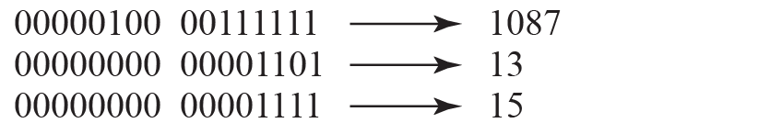
Checksum Calculation
At the sender:
1087 | 13
15 | FBA4H
Application Data (Payload)
0000 0100 0101 1011 🡪 SUM
1st compliment:
1111 1011 1010 0100 🡪 CHECKSUM
= FBA4H
At the receiver:
1087 | 13
15 | FBA4H
Application Data (Payload)
0000 0100 0011 1111 🡪 Source Port
+ 0000 0000 0000 1101 🡪 Dest Port
+ 0000 0000 0000 1111 🡪 Length
+ 1111 1011 1010 0100 🡪 Checksum
1111 1111 1111 1111 All 1’s
No Error
Transport Layer: 3-‹#›
Notes:
Add slide no 34

Slide 35
Internet checksum: an example
example: add two 16-bit integers
1 1 1 0 0 1 1 0 0 1 1 0 0 1 1 0
1 1 0 1 0 1 0 1 0 1 0 1 0 1 0 1
wraparound
1 1 0 1 1 1 0 1 1 1 0 1 1 1 0 1 1
sum
1 0 1 1 1 0 1 1 1 0 1 1 1 1 0 0
checksum
0 1 0 0 0 1 0 0 0 1 0 0 0 0 1 1
Note: when adding numbers, a carryout from the most significant bit needs to be added to the result
* Check out the online interactive exercises for more examples: http://gaia.cs.umass.edu/kurose_ross/interactive/

Slide 36
Internet checksum: weak protection!
example: add two 16-bit integers
0 1
1 1 1 0 0 1 1 0 0 1 1 0 0 1 1 0
1 0
1 1 0 1 0 1 0 1 0 1 0 1 0 1 0 1
wraparound
1 1 0 1 1 1 0 1 1 1 0 1 1 1 0 1 1
Even though numbers have changed (bit flips), no change in checksum!
sum
1 0 1 1 1 0 1 1 1 0 1 1 1 1 0 0
checksum
0 1 0 0 0 1 0 0 0 1 0 0 0 0 1 1

Slide 37
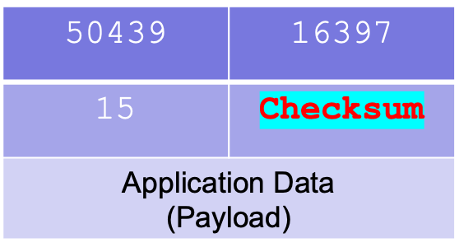
Example 1
Consider a receiver host received the segment with content given. Generate the checksum value.
Solution:
50439 🡪 11000101 00000111
16397 🡪 01000000 00001101
15 🡪 00000000 00001111
1
100000101 00100011
(Sum)
1
00000101 00100100
(Sum)
11111010 11011011
(Checksum: 1’s Complement)
FADB₁₆
(Checksum in hexadecimal)
Transport Layer: 3-‹#›
Notes:
Add slide no37

Slide 38
Example 2
Consider a receiver host received the segment with content given, check if any error occurred.
1287 | 13
15 | 7ADC₁₆
Application Data (Payload)
Solution:
1287 🡪 00000101 00000111
13 🡪 00000000 00001101
15 🡪 00000000 00001111
7ADC 🡪 01111010 11011100
Why error ???
summation result
not equal to all 1’s
01111111 11111111
(Sum)
Error !
Transport Layer: 3-‹#›
Notes:
Add slide no 38

Slide 39
Summary: UDP
“no frills” protocol:
  segments may be lost, delivered out of order
  best effort service: “send and hope for the best”
UDP has its plusses:
  no setup/handshaking needed (no RTT incurred)
  can function when network service is compromised
  helps with reliability (checksum)
build additional functionality on top of UDP in application layer (e.g., HTTP/3)

Slide 40
Chapter 3: roadmap
Transport-layer services
Multiplexing and demultiplexing
Connectionless transport: UDP
Principles of reliable data transfer
Connection-oriented transport: TCP
Principles of congestion control
TCP congestion control
Evolution of transport-layer functionality

Slide 41
Principles of reliable data transfer (rdt)
sending process
receiving process
application
data
data
transport
reliable channel
reliable service abstraction
Notes:
note arrows through reliable data transfer channel is just one way – reliably send from sender to receiver

Slide 42
Principles of reliable data transfer (rdt)
sending process
receiving process
sending process
receiving process
application
data
data
application
data
data
transport
transport
reliable channel
sender-side of
reliable data transfer protocol
receiver-side
of reliable data transfer protocol
reliable service abstraction
transport
network
unreliable channel
reliable service implementation
Notes:
Spend some time talking about how its to the sender and receiver side protocol that IMPLEMENTS reliable data transfer
Communication over unreliable channel is TWO-way: sender and receiver will exchange messages back and forth to IMPLEMENT one-way reliable data transfer

Slide 43
Principles of reliable data transfer (rdt)
sending process
receiving process
application
data
data
transport
sender-side of
reliable data transfer protocol
receiver-side
of reliable data transfer protocol
Complexity of reliable data transfer protocol will depend (strongly) on characteristics of unreliable channel (lose, corrupt, reorder data?)
transport
network
unreliable channel
reliable service implementation
Notes:
So we have a sender side and a receiver side. How much work they’ll have to do depends on the IMPAIRMENTS introduced by channel – if the channel is perfect – no problem!

Slide 44
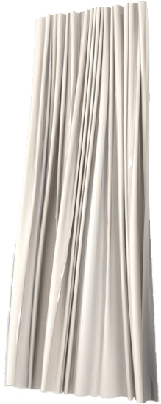
Principles of reliable data transfer (rdt)
sending process
receiving process
application
data
data
transport
sender-side of
reliable data transfer protocol
receiver-side
of reliable data transfer protocol
Sender, receiver do not know the “state” of each other, e.g., was a message received?
unless communicated via a message
transport
network
unreliable channel
reliable service implementation
Notes:
Here’s a point of view to keep in mind – it’s easy for US to look at sender and receiver together and see what is happening. OH – that message sent was lost.
But think about it say from senders POV How does the sender know if its transmitted message over the unreliable channel got though?? ONLY if receiver somehow signals to the sender that it was received.
The key point here is that one side does NOT know what is going on at the other side – it’s as if there’s a curtain between them. Everything they know about the other can ONLY be learned by sending/receiving messages.
Sender process wants to make sure a segment got through. But it can just somehow magically look through curtain to see if receiver got it. It will be up to the receiver to let the sender KNOW that it (the receiver) has correctly received the segment.
How will the sender and receiver do that – that’s the PROTOCOL.
Before starting to develop a protocol, let’s look more closely at the interface (the API if you will)

Slide 45
Reliable data transfer protocol (rdt): interfaces
rdt_send(): called from above, (e.g., by app.). Passed data to deliver to receiver upper layer
deliver_data(): called by rdt to deliver data to upper layer
sending process
receiving process
rdt_send()
data
data
deliver_data()
data
sender-side
implementation of rdt reliable data transfer protocol
receiver-side
implementation of rdt reliable data transfer protocol
packet
udt_send()
Header
data
Header
data
rdt_rcv()
unreliable channel
udt_send(): called by rdt
to transfer packet over
unreliable channel to receiver
rdt_rcv(): called when packet arrives on receiver side of channel
Bi-directional communication over unreliable channel

Slide 46
Reliable data transfer (rdt): getting started
We will:
incrementally develop sender, receiver sides of reliable data transfer protocol (rdt)
consider only unidirectional data transfer
  but control info will flow in both directions!
Notes:
SO let’s get started in developing our reliable data transfer protocol, which we’ll call rdt (need a good acronym for protocol – like HTTP, TCP, UDP, IP)
Bullet points 1 and 2
NOW if we are going to develop a protocol, so we’ll need some way to SPECIFY a protocol. How do we do that?
We could write text, but as all know, that’s prone to misinterpretation, and might be incomplete. You might write a specification, and then think “oh yeah – I forgot about that case”
What we need is more formal way to specify a protocol. In fact, with a formal specification there may be ways to PROVE PROPERTIES about a specification. But that’s an advanced topic we won’t get into here. We’ll start here by adopting a fairly simple protocol specification technique known as finite state machines (FSM)
And as the name might suggest, a central notion of finite state machines is the notion of STATE
<talk about state>

Slide 47

rdt1.0: reliable transfer over a reliable channel
underlying channel perfectly reliable
  no bit errors
  no loss of packets
no need to provide feedback to sender
no need for the rcv to ask sender to slow down sending rate
Notes:
We’ll start with the simplest case possible - an unreliable channel that is, in fact perfect – no segments are lost, corrupted, dupplicated or reordered. The sender just sends and it pops out the other side(perhaps after some delay) perfectly.
Add:
no need to provide feedback to sender
no need for the rcv to ask sender to slow down sending rate

Slide 48
rdt2.0: channel with bit errors
underlying channel may flip bits in packet
  checksum (e.g., Internet checksum) to detect bit errors
the question: how to recover from errors?
How do humans recover from “errors” during conversation?

Slide 49
rdt2.0: channel with bit errors
underlying channel may flip bits in packet
  checksum to detect bit errors
the question: how to recover from errors?
  acknowledgements (ACKs): receiver explicitly tells sender that pkt received OK
  negative acknowledgements (NAKs): receiver explicitly tells sender that pkt had errors
  sender retransmits pkt on receipt of NAK
new mechanisms in rdt2.0 (beyond rdt1.0):
  error detection
  feedback: control msgs (ACK,NAK) from receiver to sender
stop and wait
sender sends one packet, then waits for receiver response
Notes:
Add:
new mechanisms in rdt2.0 (beyond rdt1.0):
error detection
feedback: control msgs (ACK,NAK) from receiver to sender

Slide 50
rdt2.0 has a fatal flaw!
what happens if ACK/NAK corrupted?
sender doesn’t know what happened at receiver!
can’t just retransmit: possible duplicate
handling duplicates:
sender retransmits current pkt if ACK/NAK corrupted
sender adds sequence number to each pkt
receiver discards (doesn’t deliver up) duplicate pkt
stop and wait
sender sends one packet, then waits for receiver response

Slide 51
rdt2.1: sender, handling garbled ACK/NAKs
rdt_send(data)
sndpkt = make_pkt(0, data, checksum)
udt_send(sndpkt)
rdt_rcv(rcvpkt) && (corrupt(rcvpkt) ||
isNAK(rcvpkt) )
Wait for call 0 from above
Wait for ACK or NAK 0
udt_send(sndpkt)
rdt_rcv(rcvpkt)
&& notcorrupt(rcvpkt) && isACK(rcvpkt)
rdt_rcv(rcvpkt)
&& notcorrupt(rcvpkt)
&& isACK(rcvpkt)
Λ
Λ
Wait for ACK or NAK 1
Wait for
call 1 from above
rdt_rcv(rcvpkt)
&& (corrupt(rcvpkt) ||
isNAK(rcvpkt) )
rdt_send(data)
udt_send(sndpkt)
sndpkt = make_pkt(1, data, checksum)
udt_send(sndpkt)

Slide 52
rdt2.1: receiver, handling garbled ACK/NAKs
rdt_rcv(rcvpkt) && notcorrupt(rcvpkt)
&& has_seq0(rcvpkt)
extract(rcvpkt,data)
deliver_data(data)
sndpkt = make_pkt(ACK, chksum)
udt_send(sndpkt)
rdt_rcv(rcvpkt) && (corrupt(rcvpkt)
rdt_rcv(rcvpkt) && (corrupt(rcvpkt)
sndpkt = make_pkt(NAK, chksum)
udt_send(sndpkt)
sndpkt = make_pkt(NAK, chksum)
udt_send(sndpkt)
Wait for
0 from below
Wait for
1 from below
rdt_rcv(rcvpkt) &&
not corrupt(rcvpkt) &&
has_seq1(rcvpkt)
rdt_rcv(rcvpkt) &&
not corrupt(rcvpkt) &&
has_seq0(rcvpkt)
sndpkt = make_pkt(ACK, chksum)
udt_send(sndpkt)
sndpkt = make_pkt(ACK, chksum)
udt_send(sndpkt)
rdt_rcv(rcvpkt) && notcorrupt(rcvpkt)
&& has_seq1(rcvpkt)
extract(rcvpkt,data)
deliver_data(data)
sndpkt = make_pkt(ACK, chksum)
udt_send(sndpkt)

Slide 53
rdt2.1: discussion
sender:
seq # added to pkt
two seq. #s (0,1) will suffice. Why?
must check if received ACK/NAK corrupted
twice as many states
  state must “remember” whether “expected” pkt should have seq # of 0 or 1
receiver:
must check if received packet is duplicate
  state indicates whether 0 or 1 is expected pkt seq #
note: receiver can not know if its last ACK/NAK received OK at sender

Slide 54
rdt2.2: a NAK-free protocol
same functionality as rdt2.1, using ACKs only
instead of NAK, receiver sends ACK for last pkt received OK
  receiver must explicitly include seq # of pkt being ACKed
duplicate ACK at sender results in same action as NAK: retransmit current pkt
As we will see, TCP uses this approach to be NAK-free

Slide 55
rdt3.0: channels with errors and loss
New channel assumption: underlying channel can also lose packets (data, ACKs)
  checksum, sequence #s, ACKs, retransmissions will be of help … but not quite enough
Q: How do humans handle lost sender-to-receiver words in conversation?

Slide 56
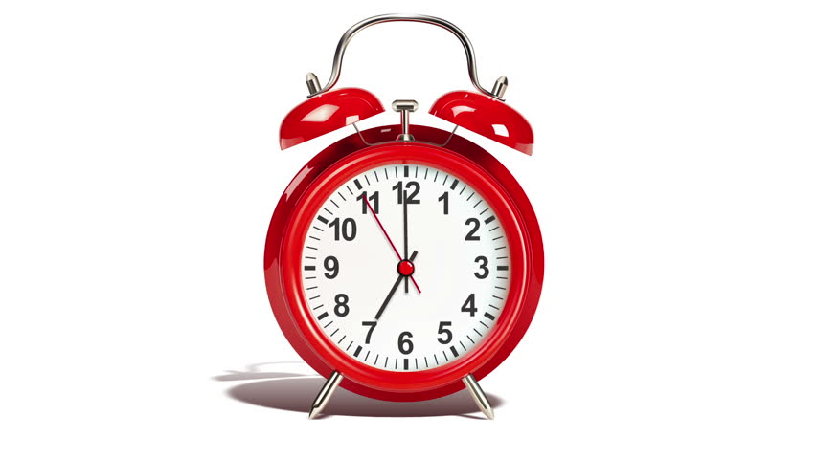
rdt3.0: channels with errors and loss
Approach: sender waits “reasonable” amount of time for ACK
retransmits if no ACK received in this time
if pkt (or ACK) just delayed (not lost):
    retransmission will be duplicate, but seq #s already handles this!
    receiver must specify seq # of packet being ACKed
use countdown timer to interrupt after “reasonable” amount of time
timeout

Slide 57

rdt3.0 in action (stop and wait)
sender
receiver
sender
receiver
send pkt0
pkt0
send pkt0
pkt0
rcv pkt0
rcv pkt0
ack0
send ack0
ack0
send ack0
rcv ack0
rcv ack0
send pkt1
pkt1
send pkt1
pkt1
rcv pkt1
X
ack1
send ack1
loss
rcv ack1
send pkt0
pkt0
rcv pkt0
timeout
resend pkt1
ack0
send ack0
pkt1
rcv pkt1
ack1
send ack1
rcv ack1
send pkt0
pkt0
(a) no loss
rcv pkt0
ack0
send ack0
(b) packet loss

Slide 58
rdt3.0 in action (stop and wait)
sender
receiver
sender
receiver
send pkt0
pkt0
rcv pkt0
send pkt0
pkt0
send ack0
rcv pkt0
rcv ack0
ack0
ack0
send ack0
send pkt1
pkt1
rcv ack0
rcv pkt1
send pkt1
pkt1
send ack1
rcv pkt1
ack1
ack1
send ack1
X
timeout
resend pkt1
loss
pkt1
rcv pkt1
timeout
resend pkt1
rcv ack1
(detect duplicate)
pkt1
rcv pkt1
send ack1
send pkt0
pkt0
ack1
(detect duplicate)
rcv pkt0
rcv ack1
send ack1
rcv ack1
ack1
ack0
send ack0
send pkt0
pkt0
(ignore)
rcv pkt0
ack0
send ack0
pkt1
(c) ACK loss
(d) premature timeout/ delayed ACK

Slide 59
Self-Study
Sender
Receiver
Question:
Supposed a sender has 3 packets to be sent to a receiver.
Complete the following figure by writing down the best answer for all S# and R#. Assume that no error after S1.
What are X and Y?
What is the problem between S1 and S2?
Is the any discard packet at receiver? Why?
Send pkt0
rcv pkt0, send NAK0
(S1)
………………
Timeout 1
(S2)
(R1)
………………
……………
(S3)
(R2)
………………
……………
Timeout 2
X
(loss)
Y
(loss)
(S4)
………………
(R3)
……………
(S5)
………………
(R4)
……………
Notes:
Add Slide 66-75

Slide 60
Self-Study
Sender
Receiver
Question:
Supposed a sender has 3 packets to be sent to a receiver.
Complete the following figure by writing down the best answer for all S# and R#. Assume that no error after S1.
What are X and Y?
What is the problem between S1 and S2?
Is the any discard packet at receiver? Why?
Send pkt0
rcv pkt0, send NAK0
(S1)
………………
Timeout 1
(S2)
(R1)
………………
……………
(S3)
(R2)
………………
……………
Timeout 2
X
(loss)
Y
(loss)
(S4)
………………
(R3)
……………
(S5)
………………
(R4)
……………

Slide 61
Self-Study
Sender
Receiver
Send pkt0
Solutions:
(as in figure)
X – ACK loss, Y – packet loss
Premature timeout
Yes. Duplicate packet 0 detected at R2.
rcv pkt0, send NAK0
rcv NAK0,
send pkt0
(S1)
………………
Timeout 1
(S2)
(R1)
send pkt0
rcv pkt0, send ACK0
………………
……………
rcv ACK0,
send pkt1
(S3)
(R2)
rcv pkt0, send ACK0
………………
……………
Timeout 2
X
(loss)
Y
(loss)
(S4)
send pkt1
………………
rcv pkt1, send ACK1
(R3)
……………
rcv ACK1,
send pkt2
(S5)
………………
rcv pkt2, send ACK2
(R4)
……………

Slide 62
Self-Study
Self-Study
Sender
Receiver
Question:
Supposed a sender has 3 packets to be sent to a receiver.
Complete the following figure by writing down the best answer for all S# and R#. Assume that no error after S1.
What are X and Y?
What is the problem between S1 and S2?
Is the any discard packet at receiver? Why?
Send pkt0
rcv pkt0, send NAK0
(S1)
………………
Timeout 1
(S2)
(R1)
………………
……………
(S3)
(R2)
………………
……………
Timeout 2
X
(loss)
Y
(loss)
(S4)
………………
(R3)
……………
(S5)
………………
(R4)
……………

Slide 63
Self-Study
Self-Study
Sender
Receiver
Send pkt0
Solutions:
(in figure)
X – ACK loss, Y – packet loss
rcv pkt0, send NAK0
rcv NAK0,
send pkt0
(S1)
………………
Timeout 1
(S2)
(R1)
send pkt0
rcv pkt0, send ACK0
………………
……………
rcv ACK0,
send pkt1
(S3)
(R2)
rcv pkt0, send ACK0
………………
……………
Timeout 2
X
(loss)
Y
(loss)
(S4)
send pkt1
………………
rcv pkt1, send ACK1
(R3)
……………
rcv ACK1,
send pkt0
(S5)
………………
rcv pkt0, send ACK0
(R4)
……………

Slide 64
Self-Study
Sender
Receiver
Question:
Supposed a sender has 3 packets to be sent to a receiver.
Complete the following figure by writing down the best answer for all S# and R#. Assume that no error after S1.
What are X and Y?
What is the problem between S1 and S2?
Is the any discard packet at receiver? Why?
Send pkt0
rcv pkt0, send NAK0
(S1)
………………
Timeout 1
(S2)
(R1)
………………
……………
(S3)
(R2)
………………
……………
Timeout 2
X
(loss)
Y
(loss)
(S4)
………………
(R3)
……………
(S5)
………………
(R4)
……………

Slide 65
Self-Test
Sender
Receiver
Send pkt0
Solutions:
(in figure)
X – ACK loss, Y – packet loss
Premature timeout
Yes. Duplicate packet 0 detected at R2.
rcv pkt0, send NAK0
rcv NAK0,
send pkt0
(S1)
………………
Timeout 1
(S2)
(R1)
send pkt0
rcv pkt0, send ACK0
………………
……………
rcv ACK0,
send pkt1
(S3)
(R2)
rcv pkt0, send ACK0
………………
……………
Timeout 2
X
(loss)
Y
(loss)
(S4)
send pkt1
………………
rcv pkt1, send ACK1
(R3)
……………
rcv ACK1,
send pkt0
(S5)
………………
rcv pkt0, send ACK0
(R4)
……………

Slide 66
Self-Study
Sender
Receiver
Question:
Supposed a sender has 3 packets to be sent to a receiver.
Complete the following figure by writing down the best answer for all S# and R#. Assume that no error after S1.
What are X and Y?
What is the problem between S1 and S2?
Is the any discard packet at receiver? Why?
Send pkt0
rcv pkt0, send NAK0
(S1)
………………
Timeout 1
(S2)
(R1)
………………
……………
(S3)
(R2)
………………
……………
Timeout 2
X
(loss)
Y
(loss)
(S4)
………………
(R3)
……………
(S5)
………………
(R4)
……………

Slide 67
Self-Study
Sender
Receiver
Send pkt0
Solutions:
(in figure)
X – ACK loss, Y – packet loss
Premature timeout
Yes. Duplicate packet 0 detected at R2.
rcv pkt0, send NAK0
rcv NAK0,
send pkt0
(S1)
………………
Timeout 1
(S2)
(R1)
send pkt0
rcv pkt0, send ACK0
………………
……………
rcv ACK0,
send pkt1
(S3)
(R2)
rcv pkt0, send ACK0
………………
……………
( R2 )
Timeout 2
X
(loss)
Y
(loss)
(S4)
send pkt1
………………
rcv pkt1, send ACK1
(R3)
……………
rcv ACK1,
send pkt0
(S5)
………………
rcv pkt0, send ACK0
(R4)
……………

Slide 68
Performance of rdt3.0 (stop-and-wait)
  rdt3.0 is functionally correct, but performance stinks (low)
  U _{sender}: utilization – fraction of time sender busy sending
example: 1 Gbps link, 15 ms prop. delay, 8000 bit packet
  time to transmit packet into channel:
L
8000 bits
D_{trans} =
=
=
8 microsecs = 0.008ms
R
10⁹ bits/sec
Notes:
if RTT=30 msec, 1KB pkt every 30 msec: 33kB/sec thruput over 1 Gbps link
network protocol limits use of physical resources
Add:
rdt3.0 is functionally correct, but performance stinks (low)
Let’s develop a formula for utilization

Slide 69
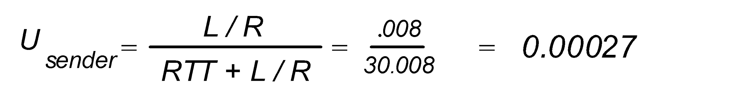
Performance of rdt3.0 (stop-and-wait)
sender
receiver
first packet bit transmitted, t = 0
last packet bit transmitted, t = L / R
first packet bit arrives
RTT
last packet bit arrives, send ACK
ACK arrives, send next
packet, t = RTT + L / R
RTT= 30ms
= 0.027%
Throughtput =1Gbps x 0.027% = 270 Kbps
Problem: network protocol limits use of physical resources/underlying infrastructure (channel)!
Notes:
Add Slide 79

Slide 70

rdt3.0: pipelined protocols operation
pipelining: sender allows multiple, “in-flight”, yet-to-be-acknowledged packets
  range of sequence numbers must be increased
  buffering at sender and/or receiver
two generic forms of pipelined protocols: go-Back-N, selective repeat

Slide 71
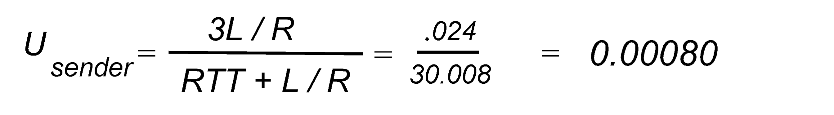
Pipelining: increased utilization
sender
receiver
first packet bit transmitted, t = 0
last bit transmitted, t = L / R
first packet bit arrives
RTT
last packet bit arrives, send ACK
last bit of 2nd packet arrives, send ACK
last bit of 3rd packet arrives, send ACK
ACK arrives, send next
packet, t = RTT + L / R
3-packet pipelining increases
utilization by a factor of 3!
= 0.080%
Notes:
two generic forms of pipelined protocols: go-Back-N, selective repeat

Slide 72
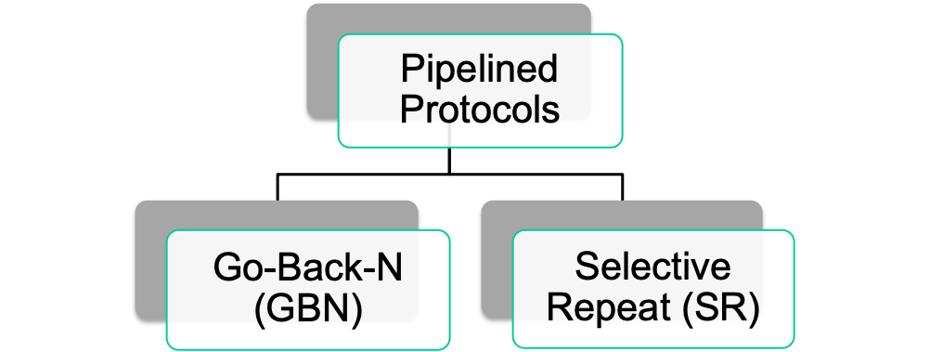
Pipelined protocols: overview
Figure: Two basic approaches of pipelined toward error recovery
The range of sequence # needed and the buffering requirements depend on the manner in which a data transfer protocol responds to:
  lost, corrupted, and overly delayed packets.

Slide 73
Pipelined protocols: overview
Go-back-N:
sender can have up to N unacked packets in pipeline
receiver only sends cumulative ack
  doesn't ack packet if there’s a gap
sender has timer for oldest unacked packet
  when timer expires, retransmit all unacked packets
Selective Repeat:
sender can have up to N unack’ed packets in pipeline
rcvr sends individual ack for each packet
sender maintains timer for each unacked packet
  when timer expires, retransmit only that unacked packet
Notes:
Add Slide 82

Slide 74

Go-Back-N (GBN): sender
sender: “window” of up to N, consecutive transmitted but unACKed pkts
  k-bit seq # in pkt header
cumulative ACK: ACK(n): ACKs all packets up to, including seq # n
  on receiving ACK(n): move window forward to begin at n+1
timer for oldest in-flight packet
timeout(n): retransmit packet n and all higher seq # packets in window
Notes:
window size of 14, 8 have been sent but are not yet ackowledgedm 6 sequence numbers are available for us. In woindow, but no calls from above to use them.
Note – we’ll skip the Go-Back-N FSM specification you can chack that out in powerpoitn slides or book)
TCP uses cumulative ACK

Slide 75
Go-Back-N: receiver
ACK-only: always send ACK for correctly-received packet so far, with highest in-order seq #
  may generate duplicate ACKs
  need only remember rcv_base
on receipt of out-of-order packet:
  can discard (don’t buffer) or buffer: an implementation decision
  re-ACK pkt with highest in-order seq #
Receiver view of sequence number space:
received and ACKed
…
…
Out-of-order: received but not ACKed
rcv_base
Not received
Notes:
Note – we’ll skip the Go-Back-N FSM specification (actually it’s

Slide 76
Go-Back-N in action
sender window (N=4)
sender
receiver
0 1 2 3 4 5 6 7 8
send pkt0
send pkt1
send pkt2
send pkt3
(wait)
0 1 2 3 4 5 6 7 8
receive pkt0, send ack0
receive pkt1, send ack1
receive pkt3, discard,
(re)send ack1
0 1 2 3 4 5 6 7 8
X
0 1 2 3 4 5 6 7 8
loss
0 1 2 3 4 5 6 7 8
rcv ack0, send pkt4
0 1 2 3 4 5 6 7 8
rcv ack1, send pkt5
receive pkt4, discard,
(re)send ack1
ignore duplicate ACK
receive pkt5, discard,
(re)send ack1
pkt 2 timeout
0 1 2 3 4 5 6 7 8
send pkt2
send pkt3
send pkt4
send pkt5
0 1 2 3 4 5 6 7 8
0 1 2 3 4 5 6 7 8
rcv pkt2, deliver, send ack2
rcv pkt3, deliver, send ack3
rcv pkt4, deliver, send ack4
rcv pkt5, deliver, send ack5
0 1 2 3 4 5 6 7 8
Notes:
Let’s skip FSM specification for GBN – check out the book or ppt – and let’s watch GBN sender and receivers in action.
Let assume a window size of 4. at t=0, sender sends packets 0, 1, 2 3, 4, and packet 2 will be lost
At the receiver:
Packet 0 received ACK0 generated
Packet 1 received ACK1 generated
Packet 2 is lost, and so when packet 3 is received, ACK 1 is sent – that’s the cumulative ACK, re-Acknowledging the receipt of packet 1. and in this implementation packet 3 is discarded

Slide 77
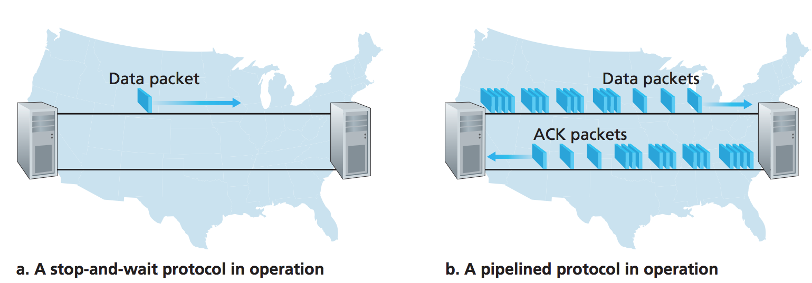
Go-Back-N (GBN): Weakness
The GBN protocol allows the sender to potentially “fill the pipeline” with packets
thus avoiding the channel utilization problems we noted with stop- and-wait protocols.
Notes:
Add Slide 88-89

Slide 78
Go-Back-N (GBN): Weakness
BUT … GBN itself can suffers from performance problems;
When the window size and bandwidth-delay are both large, many packets can be in the pipeline.
  A single packet error can thus cause GBN to retransmit a large number of packets, many unnecessarily.
  As the probability of channel errors increases, the pipeline can be filled with these unnecessary retransmissions.
Thus, “selective-repeat” protocols avoid unnecessary retransmissions by having the sender retransmit only those packets that it suspects were received in error
  (that is, were lost or corrupted) at the receiver.

Slide 79
Selective repeat (SR)
receiver individually acknowledges all correctly received packets
  buffers packets, as needed, for eventual in-order delivery to upper layer
sender times-out/retransmits individually for unACKed packets
  sender maintains timer for each unACKed pkt
sender window
  N consecutive seq #s
  limits seq #s of sent, unACKed packets
Notes:
An important mechanism of GBN was the use of the cumulative acknowledgements, and as we mentioned, cumulative ACKs are used in TCP
An alternate ACK mechanism would be for the receiver to indiviually acknowledge specific packets as they are received. This mechanism is at the heart of the Selective repeat protocol.

Slide 80

Selective repeat (SR): sender, receiver windows

Slide 81
Selective repeat (SR): sender and receiver
sender
receiver
data from above:
if next available seq # in window, send packet
timeout(n):
resend packet n, restart timer
ACK(n) in [sendbase,sendbase+N]:
mark packet n as received
if n smallest unACKed packet, advance window base to next unACKed seq #
packet n in [rcvbase, rcvbase+N-1]
send ACK(n)
out-of-order: buffer
in-order: deliver (also deliver buffered, in-order packets), advance window to next not-yet-received packet
packet n in [rcvbase-N,rcvbase-1]
ACK(n)
otherwise:
ignore
Notes:
If the packet is in order, its data will be delivered, as will any buffered data that can now be delived in order

Slide 82
Selective Repeat (SR) in action
sender window (N=4)
sender
receiver
0 1 2 3 4 5 6 7 8
send pkt0
send pkt1
send pkt2
send pkt3
(wait)
0 1 2 3 4 5 6 7 8
receive pkt0, send ack0
receive pkt1, send ack1
receive pkt3, buffer,
send ack3
0 1 2 3 4 5 6 7 8
X
0 1 2 3 4 5 6 7 8
loss
0 1 2 3 4 5 6 7 8
rcv ack0, send pkt4
0 1 2 3 4 5 6 7 8
rcv ack1, send pkt5
receive pkt4, buffer,
send ack4
record ack3 arrived
receive pkt5, buffer,
send ack5
pkt 2 timeout
0 1 2 3 4 5 6 7 8
send pkt2
(but not 3,4,5)
0 1 2 3 4 5 6 7 8
0 1 2 3 4 5 6 7 8
rcv pkt2; deliver pkt2,
pkt3, pkt4, pkt5; send ack2
0 1 2 3 4 5 6 7 8
Q: what happens when ack2 arrives?

Slide 83
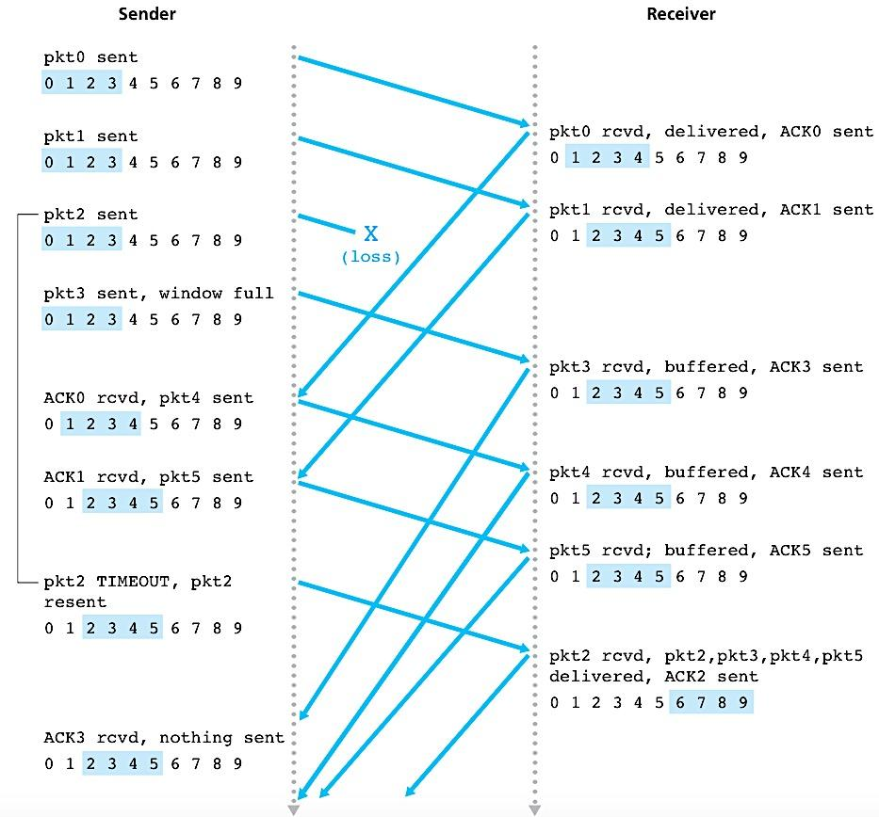
Selective Repeat (SR): Operation
X
(loss)
buffered
buffered
buffered
pkt2 timeout

Slide 84

Selective Repeat (SR): Operation
X
(loss)
pkt2 timeout

Slide 85

Selective repeat (SR): dilemma
sender window
(after receipt)
receiver window
(after receipt)
0 1 2 3 0 1 2
pkt0
0 1 2 3 0 1 2
pkt1
0 1 2 3 0 1 2
example:
seq #’s: 0, 1, 2, 3
window size=3
0 1 2 3 0 1 2
pkt2
0 1 2 3 0 1 2
0 1 2 3 0 1 2
0 1 2 3 0 1 2
pkt3
X
0 1 2 3 0 1 2
pkt0
will accept packet
with seq number 0
receiver sees no difference in two scenarios!
duplicate data accepted as new in (b)
Q: what relationship between seq # size and window size to avoid problem in (b)?
(a) no problem
receiver can’t see sender side.
receiver behavior identical in both cases!
something’s (very) wrong!
0 1 2 3 0 1 2
pkt0
0 1 2 3 0 1 2
pkt1
0 1 2 3 0 1 2
0 1 2 3 0 1 2
pkt2
0 1 2 3 0 1 2
X
0 1 2 3 0 1 2
X
timeout
retransmit pkt0
X
0 1 2 3 0 1 2
pkt0
will accept packet
with seq number 0
(b) oops!

Slide 86
Chapter 3: roadmap
Transport-layer services
Multiplexing and demultiplexing
Connectionless transport: UDP
Principles of reliable data transfer
Connection-oriented transport: TCP
  segment structure
  reliable data transfer
  flow control
  connection management
Principles of congestion control
TCP congestion control

Slide 87
(3.5) Connection-Oriented Transport:
P - Overview
TCP: Overview RFCs: 793,1122, 2018, 5681, 7323
TCP = Transmission Control Protocol
Connection-oriented protocol
Provides a reliable unicast end-to-end byte stream over an unreliable internetwork (i.e. IP internetwork)
Byte stream
Byte stream
TCP
TCP
IP internetwork
Notes:
Add slide 98

Slide 88
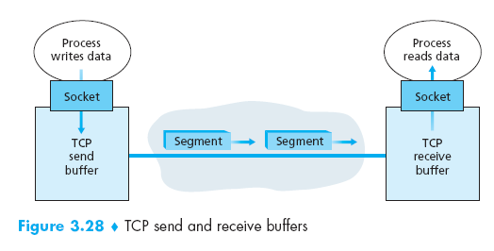
TCP: Overview RFCs: 793,1122, 2018, 5681, 7323
point-to-point:
  one sender, one receiver
reliable, in-order byte steam:
  no “message boundaries”
cumulative ACKs
pipelining:
  TCP congestion and flow control set window size
full duplex data:
  bi-directional data flow in same connection
  MSS: maximum segment size
connection-oriented:
  handshaking (exchange of control messages) initializers sender, receiver state before data exchange
flow controlled:
  sender will not overwhelm receiver
Notes:
Add slide 99-102

Slide 89
(3.5) Connection-Oriented Transport:
P - Overview
TCP: Overview
Connection oriented
  Before any data transfer, TCP establishes a connection:
    One TCP entity is waiting for a connection ( “server” )
    The other TCP entity ( “client” ) contacts the server
CLIENT
SERVER
Request connection
Waiting for
connection
request
Acknowledge request
Data transfer

Slide 90
(3.5) Connection-Oriented Transport:
P - Overview
TCP: Overview
Reliable
  Byte stream is broken up into chunks which are called segments
    Receiver sends acknowledgements (ACKs) for segments
    TCP maintains a timer. If an ACK is not received in time, the segment is retransmitted
Detecting errors
  TCP has checksums for header and data.
    Segments with invalid checksums are discarded
  Each byte that is transmitted has a sequence number
    If some intermediate sequence number is missing the receiver knows that something has been lost.

Slide 91
(3.5) Connection-Oriented Transport:
P - Overview
TCP: Overview
Byte stream service
  To the lower layers TCP handles data in blocks (i.e. the segments)
  To the higher layers, TCP handles data as a sequence of bytes and does not identify boundaries between bytes
  So; higher layers do not know about the beginning and end of segments

Slide 92
(3.5) Connection-Oriented Transport:
P - Overview
TCP: Overview
Byte stream service
Application
write 100 bytes
write 20 bytes
Application
read 40 bytes
read 40 bytes
read 40 bytes
sequences of
TCP bytes to be
transmitted
sequences of
TCP bytes that
have been
received
Notes:
Add Slide 103-104

Slide 93
(3.5) Connection-Oriented Transport:
P - Overview
TCP segment structure
The unit of data transfer between devices using TCP is a segment
20 to 60 byte of header, followed by data
  20 byte header if there are no options
  and up to 60 bytes if contains some options

Slide 94
TCP segment structure
32 bits
source port #
dest port #
segment seq #: counting bytes of data into bytestream (not segments!)
ACK: seq # of next expected byte; A bit: this is an ACK
sequence number
acknowledgement number
length (of TCP header)
head
len
not
used
A
P
S
receive window
flow control: # bytes receiver willing to accept
C
E
U
R
F
Internet checksum
checksum
Urg data pointer
options (variable length)
C, E: congestion notification
TCP options
application
data
(variable length)
data sent by application into TCP socket
RST, SYN, FIN: connection management
Notes:
Hide slide 105

Slide 95
TCP segment structure
32 bits
URG: urgent data
(generally not used)
counting
by bytes
of data
(not segments!)
source port #
dest port #
sequence number
ACK: ACK #
valid
acknowledgement number
head
len
not
used
U
receive window
A
PSH: push data now
(generally not used)
P
R
S
F
# bytes
rcvr willing
to accept
checksum
Urg data pointer
RST, SYN, FIN:
connection estab
(setup, teardown
commands)
options (variable length)
application
data
(variable length)
Internet
checksum
(as in UDP)
Notes:
Add slide 106(more info)

Slide 96
Source port address
  16 bit
  Defines the port number of the application program on the host that is sending the segment
Destination port address
  16 bit
  Defines the port number of the application program on the host that is receiving the segment
Transport Layer: 3-‹#›
Notes:
Add slide 107-108

Slide 97
Sequence number
  32 bit
  Defines the number assigned to the first byte of data contained in the segment
  During connection establishment, a random number generator is used to create an initial sequence number (ISN)
Acknowledgement number
  32 bit
  Defines the byte number that the receiver of the segment is expecting to receive from the other party
Transport Layer: 3-‹#›

Slide 98
TCP sequence numbers, ACKs
outgoing segment from sender
Sequence numbers:
  byte stream “number” of first byte in segment’s data
source port #
dest port #
sequence number
acknowledgement number
rwnd
checksum
urg pointer
window size
N
Acknowledgements:
  seq # of next byte expected from other side
  cumulative ACK
  sender sequence number space
sent
ACKed
sent, not-yet ACKed
(“in-flight”)
usable
but not
yet sent
not
usable
Q: how receiver handles out-of-order segments
  A: TCP spec doesn’t say, - up to implementor
outgoing segment from receiver
source port #
dest port #
sequence number
acknowledgement number
A
rwnd
checksum
urg pointer

Slide 99
TCP sequence numbers, ACKs
Host A
Host B
User types‘C’
Seq=42, ACK=79, data = ‘C’
host ACKs receipt of‘C’, echoes back ‘C’
Seq=79, ACK=43, data = ‘C’
host ACKs receipt of echoed ‘C’
Seq=43, ACK=80
simple telnet scenario
Notes:
The key thing to note here is that the ACK number (43) on the B-to-A segment is one more than the sequence number (42) on the A-toB segment that triggered that ACK
Similarly, the ACK number (80) on the last A-to-B segment is one more than the sequence number (79) on the B-to-A segment that triggered that ACK

Slide 100
Control
  6 bit
  Defines 6 control flags
URG: Urgent pointer is valid ( generally not used ) ACK: Acknowledgement is valid PSH: Request for push ( generally not used ) |  |  | RST: Reset the connection SYN: Synchronize sequence number FIN: Terminate the connection
URG | ACK | PSH | RST | SYN | FIN
Notes:
Add slide 111-113

Slide 101
Header length
  4 bit
  Indicates the length of this TCP header
Reserved
  6 bit
  Reserved for future use

Slide 102
Window size
  16 bit
  Defines the size of the sliding window, in bytes, that the other party must maintain
Checksum
  16 bit
  Contains checksum value for error checking
  Same calculation as UDP
  Inclusion is mandatory for TCP

Slide 103
Chapter 3: roadmap
Transport-layer services
Multiplexing and demultiplexing
Connectionless transport: UDP
Principles of reliable data transfer
Connection-oriented transport: TCP
  segment structure
  reliable data transfer
  flow control
  connection management
Principles of congestion control
TCP congestion control

Slide 104
TCP reliable data transfer
TCP creates rdt service on top of IP’s unreliable service
  pipelined segments
  cumulative acks
  single retransmission timer
retransmissions triggered by:
  timeout events
  duplicate acks
let’s initially consider simplified TCP sender:
  ignore duplicate acks
  ignore flow control, congestion control
duplicate ACK,
indicating seq. # of next expected byte
Due to some reason expected seq. # is not received at receiver)

Slide 105
TCP round trip time, timeout
Q: how to set TCP timeout value?
longer than RTT, but RTT varies!
too short: premature timeout, unnecessary retransmissions
too long: slow reaction to segment loss
Q: how to estimate RTT?
SampleRTT:measured time from segment transmission until ACK receipt
  ignore retransmissions
SampleRTT will vary, want estimated RTT “smoother”
  average several recent measurements, not just current SampleRTT

Slide 106
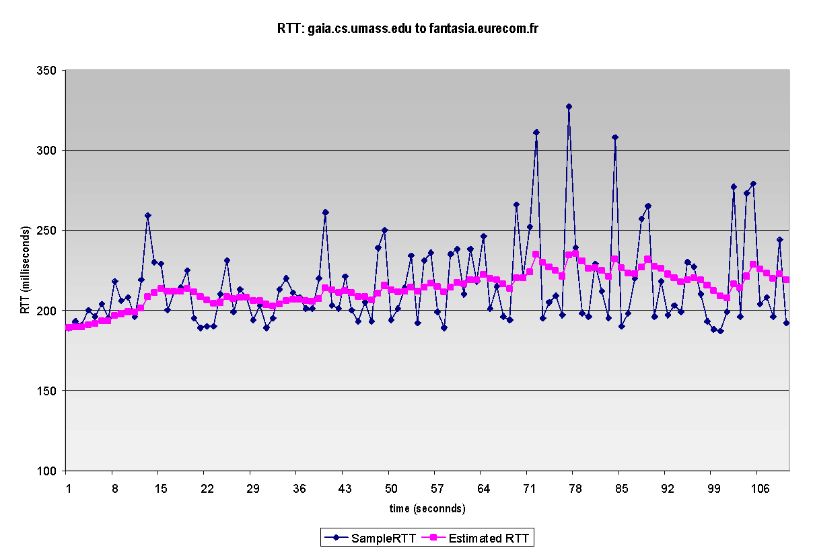
TCP round trip time, timeout
EstimatedRTT = (1- α)*EstimatedRTT + α*SampleRTT
exponential weighted moving average (EWMA)
influence of past sample decreases exponentially fast
typical value: α = 0.125
RTT: gaia.cs.umass.edu to fantasia.eurecom.fr
RTT (milliseconds)
sampleRTT
EstimatedRTT
time (seconds)
Notes:
This is how TCP re-computes the estimated RTT each time a new SampleRTT is taken.
The process is knows as an exponeitally weighted moving average, shown by the equation here.
<say it>
Where alpha reflects the influence of the most recent measurements on the estimated RTT; a typical value of alpha used in implementaitons is .125
The graph at the bottom show measured RTTs beween a host in the Massachusetts and a host in France, as well as the estimated, “smoothed” RTT

Slide 107
TCP round trip time, timeout
timeout interval: EstimatedRTT plus “safety margin”
  large variation in EstimatedRTT: want a larger safety margin
TimeoutInterval = EstimatedRTT + 4*DevRTT
estimated RTT
“safety margin”
DevRTT: EWMA of SampleRTT deviation from EstimatedRTT:
DevRTT = (1-β)*DevRTT + β*|SampleRTT-EstimatedRTT|
(typically, β = 0.25)
* Check out the online interactive exercises for more examples: http://gaia.cs.umass.edu/kurose_ross/interactive/
Notes:
Given this value of the estimated RTT, TCP computes the timeout interval to be the estimated RTT plus a “safety margin”
And the intuition is that if we are seeing a large variation in SAMPLERTT – the RTT estimates are fluctuating a lot - then we’ll want a larger savety margin
So TCP computes the Timeout interval to be the Estimated RTT plus 4 times a measure of deviation in the RTT.
The deviation in the RTT is computed as the eWMA of the difference between the most recently measured SampleRTT from the Estimated RTT

Slide 108
TCP Sender (simplified)
event: data received from application
create segment with seq #
seq # is byte-stream number of first data byte in segment
start timer if not already running
  think of timer as for oldest unACKed segment
  expiration interval: TimeOutInterval
event: timeout
retransmit segment that caused timeout
restart timer
event: ACK received
if ACK acknowledges previously unACKed segments
  update what is known to be ACKed
  start timer if there are still unACKed segments
Notes:
Given these details of TCP sequence numbers, acks, and timers, we can now describe the big picture view of how the TCP sender and receiver operate
You can check out FSMs in book; let’s just give an English text description here and let’s start with the sender.

Slide 109
TCP Receiver: ACK generation [RFC 5681]
Event at receiver
arrival of in-order segment with
expected seq #. All data up to
expected seq # already ACKed
arrival of in-order segment with
expected seq #. One other
segment has ACK pending
arrival of out-of-order segment
higher-than-expect seq. # .
Gap detected
arrival of segment that
partially or completely fills gap
TCP receiver action
delayed ACK. Wait up to 500ms
for next segment. If no next segment,
send ACK
immediately send single cumulative
ACK, ACKing both in-order segments
immediately send duplicate ACK,
indicating seq. # of next expected byte
immediate send ACK, provided that
segment starts at lower end of gap
Notes:
Rather than immediately ACKnowledig this segment, many TCP implementations will wait for half a second for another in-order segment to arrive, and then generate a single cumulative ACK for both segments – thus decreasing the amount of ACK traffic. The arrival of this second in-order segment and the cumulative ACK generation that covers both segments is the second row in this table.

Slide 110
TCP: retransmission scenarios
Host A
Host B
Host A sends a segment to Host B
  segment has sequence number 92 and contains 8 bytes of data.
After sending this segment, Host A waits for a segment from B with acknowledgment number 100.
BUT, the acknowledgment from B to A gets lost.
  … the timeout event occurs, and Host A retransmits the same segment.
Host B will discard the bytes in the retransmitted segment.
  it observes from the sequence number that the segment contains data that has already been received.
Seq=92, 8 bytes of data
timeout
ACK=100
X
Seq=92, 8 bytes of data
ACK=100
a. lost ACK scenario

Slide 111
TCP: retransmission scenarios
Host A sends two segments back to back.
  The first segment has sequence number 92 and 8 bytes of data, and the second segment has sequence number 100 and 20 bytes of data.
Suppose that both segments arrive intact at B, and B sends two separate acknowledgments for each of these segments.
  The first of these acknowledgments has acknowledgment number 100; the second has acknowledgment number 120.
Suppose now that neither of the acknowledgments arrives at Host A before the timeout.
When the timeout event occurs, Host A resends the first segment with sequence number 92 and restarts the timer.
  As long as the ACK for the second segment arrives before the new timeout, the second segment will not be retransmitted.
Host A
Host B
SendBase=92
Seq=92, 8 bytes of data
Seq=100, 20 bytes of data
timeout
ACK=100
ACK=120
Seq=92, 8
bytes of data
SendBase=100
SendBase=120
send cumulative
ACK for 120
ACK=120
SendBase=120
b. premature timeout

Slide 112
TCP: retransmission scenarios
Host A
Host B
suppose Host A sends the two segments, exactly as in the second example.
The acknowledgment of the first segment is lost in the network, but just before the timeout event,
Host A receives an acknowledgment with acknowledgment number 120.
Host A therefore knows that Host B has received everything up through byte 119; so Host A does not resend both of the two segments.
Seq=92, 8 bytes of data
Seq=100, 20 bytes of data
timeout
ACK=100
X
ACK=120
Seq=120, 15 bytes of data
c. cumulative ACK covers
for earlier lost ACK

Slide 113
TCP fast retransmit
time-out period often relatively long:
  long delay before resending lost packet
detect lost segments via duplicate ACKs.
  sender often sends many segments back-to-back
  if segment is lost, there will likely be many duplicate ACKs.

Slide 114

TCP fast retransmit
Host A
Host B
TCP fast retransmit
if sender receives 3 additional ACKs for same data (“triple duplicate ACKs”), resend unACKed segment with smallest seq #
  likely that unACKed segment lost, so don’t wait for timeout
Seq=92, 8 bytes of data
Seq=100, 20 bytes of data
X
ACK=100
timeout
ACK=100
ACK=100
Receipt of three duplicate ACKs indicates 3 segments received after a missing segment – lost segment is likely. So retransmit!
ACK=100
Seq=100, 20 bytes of data
Notes:
Let’s wrap up our study of TCP reliability by discussing an optimization to the original TCP known as TCP fast retransmit,
Take a look at this example on the right where 5 segments are transmitted and the second segment is lost. In this case the TCP receiver sends an ACK 100 acknowledging the first received segment.
When the third segment arrives at the receiver, the TCP receiver sends another ACK 100 since the second segment has not arrived. And similarly for the 4th and 5th segments to arrive.
Now what does the sender see? The sender receives the first ACK 100 it has been hoping for, but then three additional duplicate ACK100s arrive. The sender knows that somethings’ wrong – it knows the first segment arrived at the receiver but three later arriving segments at the receiver – the ones that generated the three duplicate ACKs – we received correctly but were not in order. That is, that there was a missing segment at the receiver when each of the three duplicate ACK were generated.
With fast retransmit, the arrival of three duplicate ACK causes the sender to retransmit its oldest unACKed segment, without waiting for a timeout event. This allows TCP to recover more quickly from what is very likely a loss event
specifically that the second segment has been lost, since three higher -numbered segments were received

Slide 115
TCP fast retransmit
Host A
Host B
Event @receiver:
Arrival of out-of-order segment
higher-than-expected seq#.
Gap is detected
Seq=92, 8 bytes of data
Seq=100, 20 bytes of data
X
ACK=100
Action:
Immediately send triple duplicate ACK,
Indicating seq# of next expected byte
timeout
ACK=100
ACK=100
ACK=100
Seq=100, 20 bytes of data
Sender:
detect triple duplicate ACKs
without waiting for timeout, resend the lost segment
Receipt of three duplicate ACKs indicates 3 segments received after a missing segment – lost segment is likely. So retransmit!

Slide 116
Chapter 3: roadmap
Transport-layer services
Multiplexing and demultiplexing
Connectionless transport: UDP
Principles of reliable data transfer
Connection-oriented transport: TCP
  segment structure
  reliable data transfer
  flow control
  connection management
Principles of congestion control
TCP congestion control

Slide 117
TCP flow control
When the TCP connection receives bytes that are correct and in sequence, it places the data in the receive buffer.
The associated application process will read data from this buffer, but NOT necessarily at the instant the data arrives.
Indeed, the receiving application may be busy with some other task and may not even attempt to read the data until long after it has arrived.
Notes:
Addslide 128-129

Slide 118
TCP flow control
If the application is relatively slow at reading the data,
  the sender can very easily overflow the receiver buffer by sending too much data too quickly.
TCP provides a flow-control service
  to eliminate the possibility of the sender overflowing the receiver’s buffer.
Flow control is thus a speed-matching service
  matching the rate at which the sender is sending against the rate at which the receiving application is reading.

Slide 119
TCP flow control
application
process
Q: What happens if network layer delivers data faster than application layer removes data from socket buffers?
Application removing data from TCP socket buffers
TCP socket
receiver buffers
TCP
code
Network layer delivering IP datagram payload into TCP socket buffers
IP
code
from sender
receiver protocol stack
Notes:
(Presuming an intro)
Before diving into the details of TCP flow control, let’s first get the general context and motivate the need for flow control.
This diagram show a typical transport-layer implementation
A segment is brought up the protocol stack to the transport layer, and the segment’s payload is removed from the segment and written INTO socket buffers.
How does data get taken OUT of socket buffers? By applications performing socket reads, as we learned in Chapter 2.
And so the question is “What happens if network layer delivers data faster than an application-layer process removes data from socket buffers?”
Let’s watch a video of what happens when things arrive way too fast to fast to be processed.
<video>. (I love that video). Another human analogy showing the need for flow control is the saying – to use some English slang - “no one can drink from a firehose”
Flow control is a mechanism to the calamity of a receiver being over-run by a sender that is sending too fast – it allows the RECEIVER to explictly control the SENDER so sender won’t overflow receiver’s buffer by transmitting too much, too fast

Slide 120


TCP flow control
application
process
Q: What happens if network layer delivers data faster than application layer removes data from socket buffers?
Application removing data from TCP socket buffers
TCP socket
receiver buffers
… slower than TCP
receiver is delivering
(sender is sending)
TCP
code
Network layer delivering IP datagram payload into TCP socket buffers
IP
code
from sender
receiver protocol stack
Notes:
(Presuming an intro)
Before diving into the details of TCP flow control, let’s first get the general context and motivate the need for flow control.
This diagram show a typical transport-layer implementation
A segment is brought up the protocol stack to the transport layer, and the segment’s payload is removed from the segment and written INTO socket buffers.
How does data get taken OUT of socket buffers? By applications performing socket reads, as we learned in Chapter 2.
And so the question is “What happens if network layer delivers data faster than an application-layer process removes data from socket buffers?”
Let’s watch a video of what happens when things arrive way too fast to fast to be processed.
<video>. (I love that video). Another human analogy showing the need for flow control is the saying – to use some English slang - “no one can drink from a firehose”
Flow control is a mechanism to the calamity of a receiver being over-run by a sender that is sending too fast – it allows the RECEIVER to explictly control the SENDER so sender won’t overflow receiver’s buffer by transmitting too much, too fast

Slide 121
TCP flow control
application
process
Q: What happens if network layer delivers data faster than application layer removes data from socket buffers?
Application removing data from TCP socket buffers
TCP socket
receiver buffers
TCP
code
receive window
flow control: # bytes receiver willing to accept
IP
code
from sender
receiver protocol stack
Notes:
(Presuming an intro)
Before diving into the details of TCP flow control, let’s first get the general context and motivate the need for flow control.
This diagram show a typical transport-layer implementation
A segment is brought up the protocol stack to the transport layer, and the segment’s payload is removed from the segment and written INTO socket buffers.
How does data get taken OUT of socket buffers? By applications performing socket reads, as we learned in Chapter 2.
And so the question is “What happens if network layer delivers data faster than an application-layer process removes data from socket buffers?”
Let’s watch a video of what happens when things arrive way too fast to fast to be processed.
<video>. (I love that video). Another human analogy showing the need for flow control is the saying – to use some English slang - “no one can drink from a firehose”
Flow control is a mechanism to the calamity of a receiver being over-run by a sender that is sending too fast – it allows the RECEIVER to explictly control the SENDER so sender won’t overflow receiver’s buffer by transmitting too much, too fast

Slide 122
TCP flow control
application
process
Q: What happens if network layer delivers data faster than application layer removes data from socket buffers?
Application removing data from TCP socket buffers
TCP socket
receiver buffers
TCP
code
flow control
receiver controls sender, so sender won’t overflow receiver’s buffer by transmitting too much, too fast
IP
code
from sender
receiver protocol stack
Notes:
(Presuming an intro)
Before diving into the details of TCP flow control, let’s first get the general context and motivate the need for flow control.
This diagram show a typical transport-layer implementation
A segment is brought up the protocol stack to the transport layer, and the segment’s payload is removed from the segment and written INTO socket buffers.
How does data get taken OUT of socket buffers? By applications performing socket reads, as we learned in Chapter 2.
And so the question is “What happens if network layer delivers data faster than an application-layer process removes data from socket buffers?”
Let’s watch a video of what happens when things arrive way too fast to fast to be processed.
<video>. (I love that video). Another human analogy showing the need for flow control is the saying – to use some English slang - “no one can drink from a firehose”
Flow control is a mechanism to the calamity of a receiver being over-run by a sender that is sending too fast – it allows the RECEIVER to explictly control the SENDER so sender won’t overflow receiver’s buffer by transmitting too much, too fast

Slide 123
TCP flow control
TCP receiver “advertises” free buffer space in rwnd field in TCP header
  RcvBuffer size set via socket options (typical default is 4096 bytes)
  many operating systems autoadjust RcvBuffer
sender limits amount of unACKed (“in-flight”) data to received rwnd
guarantees receive buffer will not overflow
to application process
RcvBuffer
buffered data
rwnd
free buffer space
TCP segment payloads
TCP receiver-side buffering
RcvBuffer 🡪 received buffer data
rwnd 🡪 received window size
Notes:
Here’s how TCP implement flow control. The basic idea is simple – the receiver informs the sender how much free buffer space there is, and the sender is limited to send no more than this amount of data. That the value o RWND in the diagram to the right.
This information is carried from the receiver to the sender in the “receiver advertised window” (do a PIP of header) in the TCP header, and the value will change as the amount of free buffer space fluctuates over time.

Slide 124
TCP flow control
flow control: # bytes receiver willing to accept
TCP receiver “advertises” free buffer space in rwnd field in TCP header
  RcvBuffer size set via socket options (typical default is 4096 bytes)
  many operating systems autoadjust RcvBuffer
sender limits amount of unACKed (“in-flight”) data to received rwnd
guarantees receive buffer will not overflow
receive window
TCP segment format
Notes:
Here’s how TCP implement flow control. The basic idea is simple – the receiver informs the sender how much free buffer space there is, and the sender is limited to send no more than this amount of data. That the value o RWND in the diagram to the right.
This information is carried from the receiver to the sender in the “receiver advertised window” (do a PIP of header) in the TCP header, and the value will change as the amount of free buffer space fluctuates over time.

Slide 125
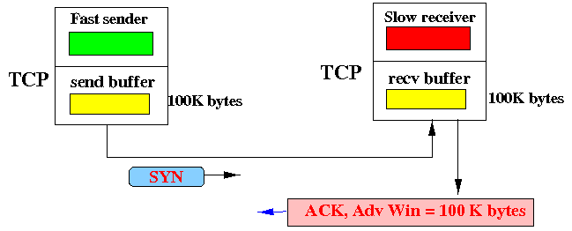
Example: TCP flow control
1
Initially, the send and receive buffer are empty.
Receiver advertises a window of 100 K bytes.
ACK, Adv Win = 100 K bytes

Slide 126
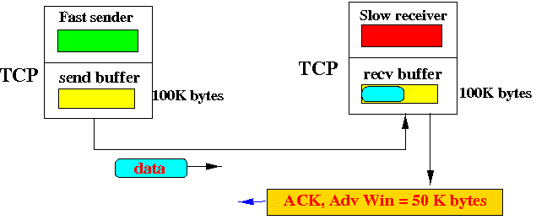
Example: TCP flow control
Sender sends many packets quickly, faster than the receiver can process...
the receive buffer starts to fill and soon the advertised window drops to 50 K bytes:
2
ACK, Adv Win = 50 K bytes

Slide 127
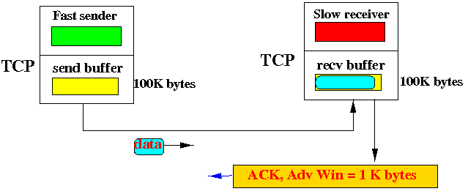
Example: TCP flow control
The situation continues and the receive buffer fills further
The ACK packets from the receiver will now have a lower advertised window, e.g., 1 K bytes:
3
ACK, Adv Win = 1 K bytes

Slide 128
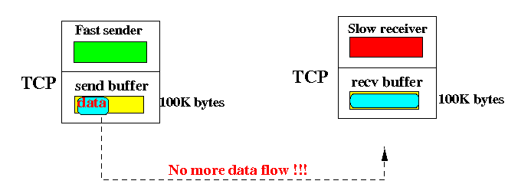
Example: TCP flow control
Sooner or later, the receive buffer fills up
The receiver returns an ACK packets with the advertised window = 0 bytes !!!
4
ACK, Adv Win = 0

Slide 129

Example: TCP flow control
… cont.; This causes the sending TCP to stop transmitting more data.....
and prevent the sending TCP to overflow the receive buffer of the receiving TCP.
4

Slide 130
TCP connection management
before exchanging data, sender/receiver “handshake”:
agree to establish connection (each knowing the other willing to establish connection)
agree on connection parameters (e.g., starting seq #s)
application
application
connection state: ESTAB
connection variables:
  seq # client-to-server
  server-to-client
  rcvBuffer size
  at server,client
connection state: ESTAB
connection Variables:
  seq # client-to-server
  server-to-client
  rcvBuffer size
  at server,client
network
network
Socket clientSocket =
newSocket("hostname","port number");
Socket connectionSocket = welcomeSocket.accept();
Notes:
The other TCP topic we’ll want to consider here is that of “connection management”
The TCP sender and reciver have a number of pieces of shared state that they must establish before actually communication
FIRST theym ust both agree that they WANT to communicate with each other
Secondly there are connection parameters – the initial sequence number and the initial receiver-advertised bufferspace that they’ll want to agree on
This is done via a so-called handshake protocol – the client reaching our to the server, and the server answering back.
And before diving into the TCP handshake protocol, let’s first consider the problem of handshaking, of establishing shared state.

Slide 131


Agreeing to establish a connection
2-way handshake:
Q: will 2-way handshake always work in network?
variable delays
retransmitted messages (e.g. req_conn(x)) due to message loss
message reordering
can’t “see” other side
Let’s talk
ESTAB
OK
ESTAB
choose x
req_conn(x)
ESTAB
acc_conn(x)
ESTAB
Notes:
Here’s an example of a two way handshake. Alice reaches out to Bob and say’s “let’s talk” and Bob says OK, and they start their conversation
For a network protocol, the equivalent protocol would be a client sending a “request connection” message saying ”let’s talk, the initial sequence number is x”
And the server would respond with a message ”I accept your connect x”
And the question we want to ask ourselves is <talk through>
Will this work? Let’s look at a few scenarios…

Slide 132

2-way handshake scenarios
choose x
req_conn(x)
ESTAB
acc_conn(x)
ESTAB
data(x+1)
accept
data(x+1)
ACK(x+1)
connection
x completes
No problem!

Slide 133

2-way handshake scenarios
choose x
req_conn(x)
ESTAB
retransmit
req_conn(x)
acc_conn(x)
ESTAB
req_conn(x)
connection
x completes
client terminates
server
forgets x
ESTAB
acc_conn(x)
Problem: half open connection! (no client)

Slide 134
2-way handshake scenarios
choose x
req_conn(x)
ESTAB
retransmit
req_conn(x)
acc_conn(x)
ESTAB
data(x+1)
accept
data(x+1)
retransmit
data(x+1)
connection
x completes
client terminates
server
forgets x
req_conn(x)
ESTAB
data(x+1)
accept
data(x+1)
Problem: dup data
accepted!

Slide 135
TCP 3-way handshake
Four actions are required before sending data
  Host A sends a segment to announce its wish for connection and includes its initialization information
  Host B sends a segment to acknowledge the request of A
  Host B sends a segment that includes initialization information
  Host A sends a segment to acknowledge the request from B
2nd and 3rd can be combined
Called Three-Way Handshaking
Notes:
Add slide 147-150

Slide 136
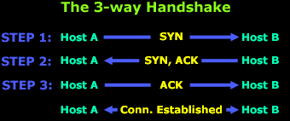
TCP 3-way handshake
STEP 1:
  Host A sends the initial packet to Host B. This packet has the "SYN" bit enabled.
  Host B receives the packet and sees the "SYN" bit enabled, so it knows that Host A is trying to establish a connection with it.

Slide 137
TCP 3-way handshake
STEP 2:
  Assuming Host B has enough resources, it sends a packet back to Host A and with the "SYN and ACK" bits enabled (set to 1).
  The SYN that Host B sends, at this step, means 'I want to synchronize with you' and the ACK means 'I acknowledge your previous SYN request'.

Slide 138
TCP 3-way handshake
STEP 3:
  Host A sends another packet to Host B and with the "ACK" bit set (1),
  … it effectively tells Host B 'Yes, I acknowledge your previous request'.

Slide 139
TCP 3-way handshake
Server state
Client state
serverSocket = socket(AF_INET,SOCK_STREAM)
serverSocket.bind((‘’,serverPort))
serverSocket.listen(1)
connectionSocket, addr = serverSocket.accept()
clientSocket = socket(AF_INET, SOCK_STREAM)
LISTEN
clientSocket.connect((serverName,serverPort))
LISTEN
choose init seq num, x
send TCP SYN msg
SYNSENT
SYNbit=1, Seq=x
choose init seq num, y
send TCP SYNACK
msg, acking SYN
SYN RCVD
SYNbit=1, Seq=y
ACKbit=1; ACKnum=x+1
received SYNACK(x)
indicates server is live;
send ACK for SYNACK;
this segment may contain
client-to-server data
ESTAB
ACKbit=1, ACKnum=y+1
received ACK(y)
indicates client is live
ESTAB
Notes:
TCP’s three way handshake, that operates as follows
Let’s say the client and server both create a TCP socket as we learned about in Chapter 2 and enter the LISTEN state
The client then connects to the server sending a SYN message with a sequence number x (SYN Message is an TCP Segment with SYN but set in the header – you might want to go back and review the TCP segment format!)
The server is waiting for a connection, and receives the SYN message enters the SYN received state (NOT the established state and sends a SYN ACK message back.
Finally the client sends an ACK message to the server, and when the server receiver this enters the ESTABLished state. This is when the application process would see the return from the wait on the socket accept() call

Slide 140
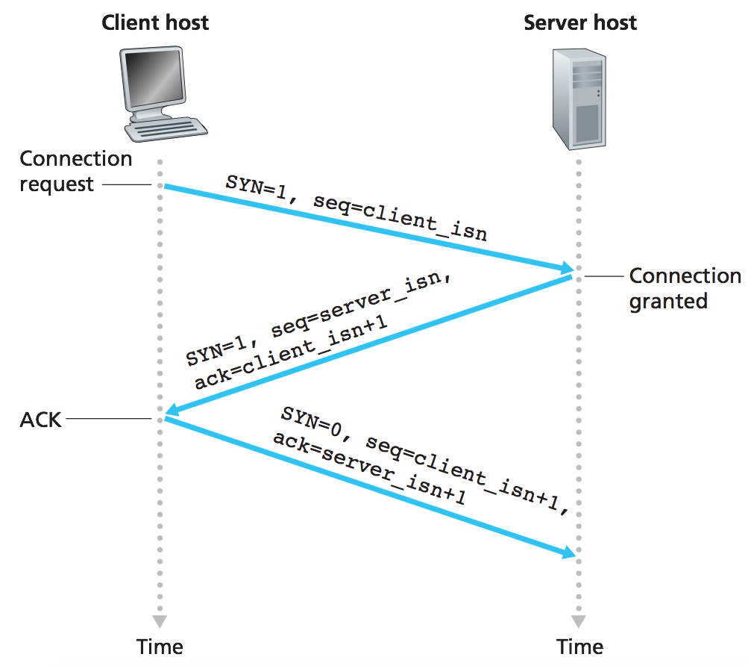
EXAMPLE 1 : TCP 3-way handshake
Client host
Server host
TCP State:
TCP State:
LISTEN
SYN_SENT
SYN=1,seq_{c}=3
SYN_RCVD
SYN=1,seq_{s}=9,ACK_{c}=4
ESTABLISHED
SYN=0,seq_{c}=4,ACK_{s}=10
ESTABLISHED
TCP 3-way handshake: segment exchange
Notes:
Add slide 152-157

Slide 141
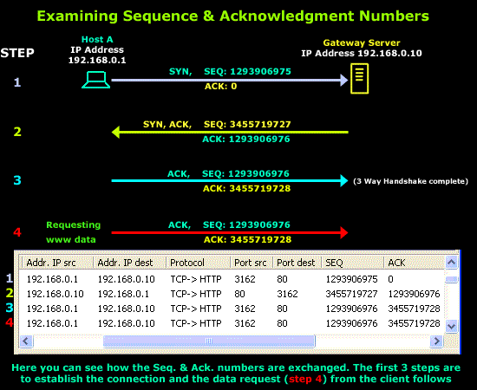
EXAMPLE 2 : Examining Sequence and Acknowledgement Numbers

Slide 142
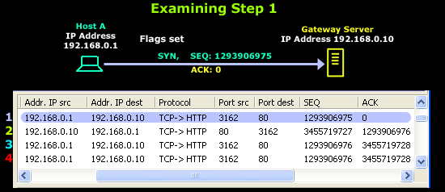
"I'd like to initiate a new connection with you.
My Sequence number is 1293906975".
EXAMPLE 2
STEP 1
Host A wishes to download a webpage from the Gateway Server.
To establish a new connection, Host A sends a packet to the Gateway Server;
  This packet has the SYN flag set ( i.e. SYN bit = 1 ) and
  also contains the ISN generated by Host A's operating system, that is 1293906975.
  the Acknowledgment number is set to zero (0),
    … since Host A is initiating the connection and hasn't received a reply from the Gateway Server

Slide 143
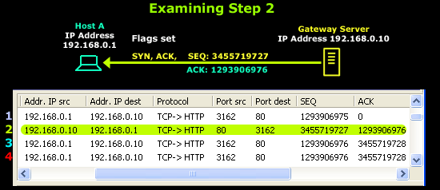
EXAMPLE 2
"I acknowledge your sequence number and
expecting your next packet with sequence number 1293906976.
My sequence number is 3455719727".
STEP 2
The Gateway Server receives Host A's request and generates a reply containing
  its own generated ISN, that is 3455719727, and
  the next Sequence number it is expecting from Host A which is 1293906976.
  also has the SYN & ACK flags set, acknowledging the previous packet it received and informing Host A of its own Sequence number.

Slide 144
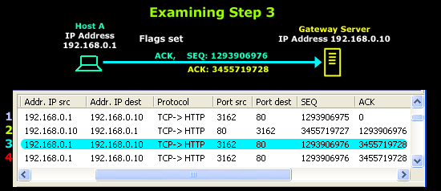
"I acknowledge your last packet.
This packet's sequence number is 1293906976,
which is what you're expecting.
I'll also be expecting the next packet you send me
to have a sequence number of 3455719728"
EXAMPLE 2
STEP 3
Host A receives the reply and now knows Gateway's sequence number.
It generates another packet to complete the connection.
  This packet has the ACK flag set and also contains
  the sequence number that it expects the Gateway Server to use next, that is 3455719728.
Since the 3-way TCP handshake has been completed, a virtual connection between the two now exists and the Gateway Server is ready to listen to Host A's request.

Slide 145
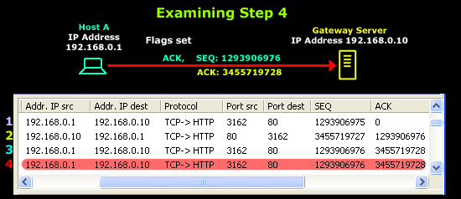
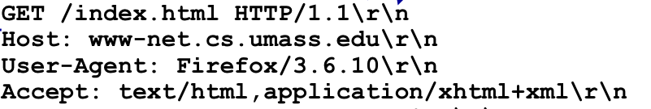
EXAMPLE 2
STEP 4
In this step, Host A generates a packet with some data and sends it to the Gateway Server.
The data tells the Gateway Server which webpage it would like sent.
… remember in Module 2

Slide 146

A human 3-way handshake protocol
1. On belay?
2. Belay on.
3. Climbing.
Notes:
As usual, there’s a human protocol analogy to the three way handshake, and I still remember thinking about this clinging for my life while climbing up a rockface
When you want start climbing you first say ON BELOW (meaning ARE YOU READY WITH MY SAFETY ROPE)
THE BELYER (server) responds BELAY ON (that lets you know the belayer is ready for you)
And then you say CLIMING
It’s amazing what can pass through your head when your clinging for your life o a

Slide 147
TCP: closing a connection
Closing connection, four actions are required:
  Host A sends a segment announcing connection termination
  Host B sends a segment acknowledging the request from A. After this the connection is closed in one direction.
  When host B has finished sending data, it sends a segment indicating connection closure
  Host A acknowledge the request from B
2nd and 3rd cannot be combined
It is called Four-Way Handshaking
Notes:
Add slide 159

Slide 148
Closing a TCP connection
client, server each close their side of connection
  send TCP segment with FIN bit = 1
respond to received FIN with ACK
  on receiving FIN, ACK can be combined with own FIN
simultaneous FIN exchanges can be handled
Notes:
All good things must come to an end, and that’s true for a TCP connection as well.
And of course there’s a protocol for one side to gracefully close of a TCP connection using a FIN message, to which the other side sends a FINACK message and waits around a bit to respond to any retransmitted FIN messages before timing out.

Slide 149
TCP: closing a connection
client state
server state
ESTAB
ESTAB
clientSocket.close()
FIN_WAIT_1
can no longer
send but can
receive data
FINbit=1, seq=x
CLOSE_WAIT
ACKbit=1; ACKnum=x+1
can still
send data
FIN_WAIT_2
wait for server
close
LAST_ACK
FINbit=1, seq=y
TIMED_WAIT
can no longer
send data
ACKbit=1; ACKnum=y+1
timed wait
for 2*max
segment lifetime
CLOSED
CLOSED
Notes:
Add slide 161-162

Slide 150
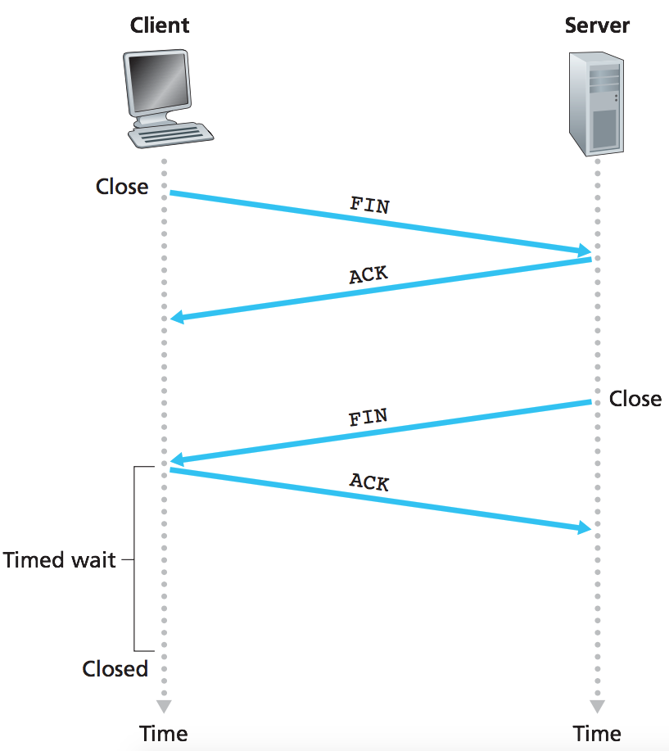
TCP: Example closing a connection
Client host
Server host
TCP State:
TCP State:
FIN_WAIT_1
FIN_{bit}=1,seq_{c}=3
can no longer
send but can
receive data
CLOSE_WAIT
ACK_{bit}=1,ACK_{c}=4
can still
send data
FIN_WAIT_2
wait for server
close
FIN_{bit}=1,seq_{s}=9
LAST_ACK
TIME_WAIT
can no longer
send data
ACK_{bit}=1,ACK_{s}=10
timed wait
for 2*max
segment lifetime
CLOSED
CLOSED
Closing a TCP connection

Slide 151
Chapter 3: roadmap
Transport-layer services
Multiplexing and demultiplexing
Connectionless transport: UDP
Principles of reliable data transfer
Connection-oriented transport: TCP
Principles of congestion control
TCP congestion control
Evolution of transport-layer functionality

Slide 152

Principles of congestion control
Congestion:
informally: “too many sources sending too much data too fast for network to handle”
manifestations:
  long delays (queueing in router buffers)
  packet loss (buffer overflow at routers)
different from flow control!
congestion control: too many senders, sending too fast
a top-10 problem!
flow control: one sender too fast for one receiver

Slide 153
Approaches towards congestion control
End-end congestion control:
no explicit feedback from network
congestion inferred from observed loss, delay
ACKs
data
data
ACKs
approach taken by TCP

Slide 154
Approaches towards congestion control
Network-assisted congestion control:
routers provide direct feedback to sending/receiving hosts with flows passing through congested router
may indicate congestion level or explicitly set sending rate
explicit congestion info
ACKs
data
data
ACKs
TCP ECN, ATM, DECbit protocols

Slide 155
Chapter 3: roadmap
Transport-layer services
Multiplexing and demultiplexing
Connectionless transport: UDP
Principles of reliable data transfer
Connection-oriented transport: TCP
Principles of congestion control
TCP congestion control
Evolution of transport-layer functionality

Slide 156
TCP congestion control: Additive Increase Multiplicative Decrease (AIMD)
approach: senders can increase sending rate until packet loss (congestion) occurs, then decrease sending rate on loss event
Additive Increase
Multiplicative Decrease
  increase cwnd sending rate by 1 maximum segment size every RTT until loss detected
  cut cwnd sending rate in half at each loss event
additively increase window size …
…. until loss occurs (then cut window in half)
AIMD sawtooth
behavior: probing
for bandwidth
cwnd: TCP sender
congestion window size
time

Slide 157
TCP AIMD: more
Multiplicative decrease detail: sending rate is
Cut in half on loss detected by triple duplicate ACK (TCP Reno)
Cut to 1 MSS (maximum segment size) when loss detected by timeout (TCP Tahoe)
Why AIMD?
AIMD – a distributed, asynchronous algorithm – has been shown to:
  optimize congested flow rates network wide!
  have desirable stability properties

Slide 158
TCP congestion control: details
sender sequence number space
TCP sending behavior:
roughly: send cwnd bytes, wait RTT for ACKS, then send more bytes
cwnd
last byte
ACKed
cwnd
sent, but not-yet ACKed
(“in-flight”)
available but not used
TCP rate
~
bytes/sec
~
RTT
last byte sent
TCP sender limits transmission:
cwnd is dynamically adjusted in response to observed network congestion (implementing TCP congestion control)
<
cwnd
LastByteSent- LastByteAcked

Slide 159
TCP slow start
Host A
Host B
when connection begins, increase rate exponentially until first loss event:
  initially cwnd = 1 MSS
  double cwnd every RTT
  done by incrementing cwnd for every ACK received
one segment
RTT
two segments
four segments
summary: initial rate is slow, but ramps up exponentially fast
time

Slide 160
TCP: detecting, reacting to loss
loss indicated by timeout:
  cwnd set to 1 MSS;
  window then grows exponentially (as in slow start) to threshold, then grows linearly
TCP Tahoe always sets cwnd to 1 (timeout or 3 duplicate ACKs)
Notes:
Add Slide 182-186

Slide 161
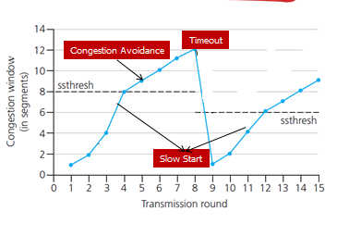
TCP: Switching From Slow Start To Congestion Avoidance (CA)
TCP TAHOE Implementation:
variable ssthresh (slow-start threshold)
on loss event:
  ssthresh is set to ½ (half) of cwnd (cwnd/2) just before loss event
  Value of cwnd is set to 1 MSS (slow start)

Slide 162
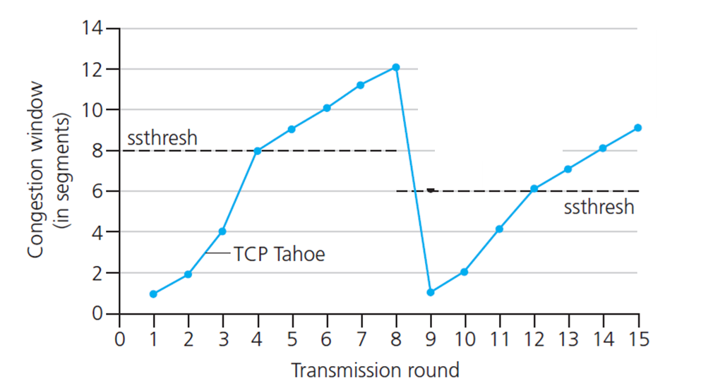
TCP: Slow Start & Congestion Avoidance (CA)
(Loss Because of Timeout)
Phase | TR | CW | SS | ssthresh
Slow Start (1) | 1 | 1 | 1 | 8
 | 2 | 2 | 3 | 8
 | 3 | 4 | 7 | 8
 | 4 | 8 | 15 | 8
CA | 5 | 9 | 24 | 8
 | 6 | 10 | 34 | 8
 | 7 | 11 | 45 | 8
 | 8 | 12 | 57 | 8
TR 1 to 4
Slow Start, Exponential growth, ssthresh=8
TR 4, CW = ssthresh is detected and Congestion Avoidance (CA) starts
TR 5 to 8
- Operate at CA, Linear growth
TR = Transmission Round
CW = Congestion Window
SS = Segment Send
ssthresh = Slow Start Threshold

Slide 163
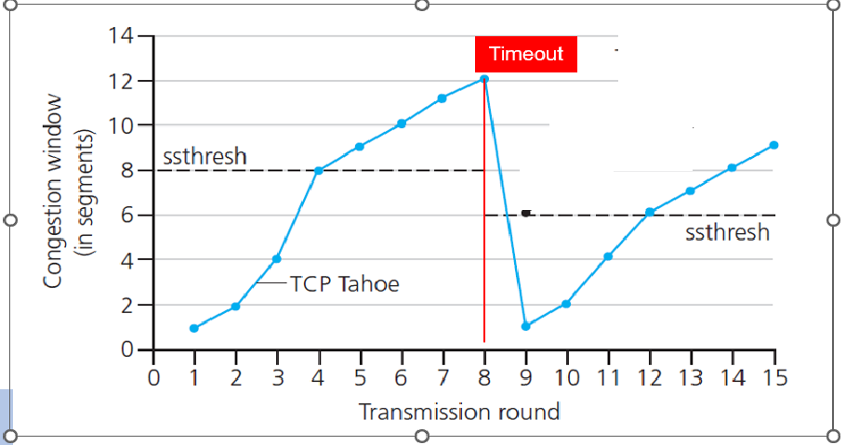
TCP: Slow Start & Congestion Avoidance (CA)
(Loss because of Timeout)
TCP Slow Start & Congestion Avoidance (CA)
Phase | TR | CW | SS | ssthresh
Slow Start (1) | 1 | 1 | 1 | 8
 | 2 | 2 | 3 | 8
 | 3 | 4 | 7 | 8
 | 4 | 8 | 15 | 8
CA | 5 | 9 | 24 | 8
 | 6 | 10 | 34 | 8
 | 7 | 11 | 45 | 8
 | 8 | 12 | 57 | 12 / 2 = 6
After TR 8
Timeout is detected
New ssthresh value will be calculated; ………..= cwnd_{timeout} / 2
………..= 12 / 2 = 6
TR = Transmission Round
CW = Congestion Window
SS = Segment Send
ssthresh = Slow Start Threshold

Slide 164
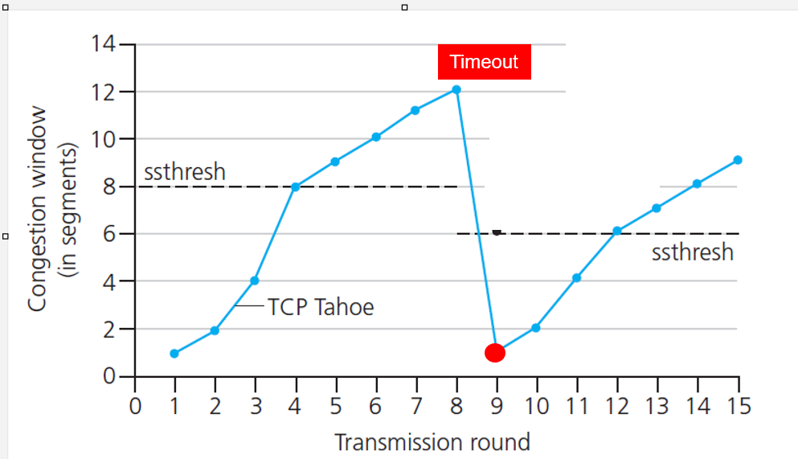
TCP: Slow Start & Congestion Avoidance (CA)
(Loss because of Timeout)
Phase | TR | CW | SS | ssthresh
Slow Start (2) | 9 | 1 | 58 | 6
 | 10 | 2 | 60 | 6
 | 11 | 4 | 64 | 6
 | 12 | 6 (8) | 70 | 6
CA | 13 | 7 | 77 | 6
 | 14 | 8 | 85 | 6
 | 15 | 9 | 94 | 6
TR 9 to 12 (refer table)
CW=1, and ssthresh=6
Start Slow, Exponential Growth
TR 13 to 15
- Operate at CA, Linear Growth
TR = Transmission Round
CW = Congestion Window
SS = Segment Send
ssthresh = Slow Start Threshold

Slide 165
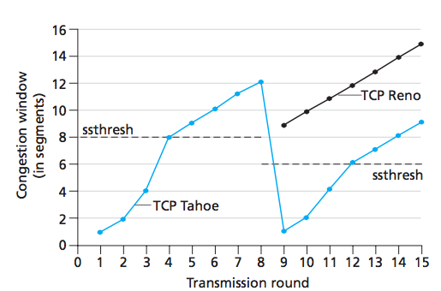
TCP: Fast Recovery
(Loss because of 3 Duplicate ACK)
Earlier version of TCP (TCP TAHOE) entered Slow start
Newer version of TCP (TCP RENO) incorporated fast recovery
Fast Recovery
3 Duplicate ACKs
Slow Start
TCP RENO Implementation
variable ssthresh (slow-start threshold)
on loss event:
  ssthresh is set to ½ (half) of cwnd(cwnd/2) just before loss event
  Set cwnd value to ssthresh plus 3 (ssthresh+3) the segment size
    The equation 🡪 cwnd=ssthresh + 3MSS
Notes:
Add slide 187-198

Slide 166
TCP: Fast Recovery
(Loss because of 3 Duplicate ACK)
TCP Fast Recovery
TR | CW | SS | ssthresh
8 | 12 | 57 | 12 / 2 = 6
TR | CW | SS | ssthresh
9
10
11
12
13
14
15
After TR 8, Triple Duplicate ACKs is detected
TR = Transmission Round
CW = Congestion Window
SS = Segment Send
ssthreshold = Slow Start Threshold

Slide 167
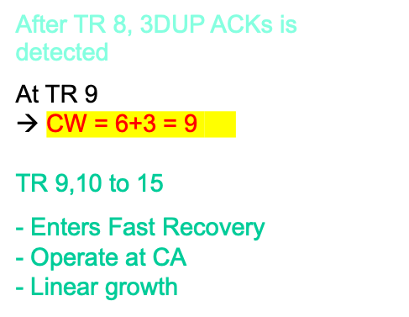
TCP: Fast Recovery
(Loss because of 3 Duplicate ACK)
TP Fast Recovery
TR | CW | SS | ssthresh
8 | 12 | 57 | 12 / 2 = 6
TR | CW | SS | ssthresh
9 | 9 | 66 | 6
10 | 10 | 76 | 6
11 | 11 | 87 | 6
12 | 12 | 99 | 6
13 | 13 | 112 | 6
14 | 14 | 126 | 6
15 | 15 | 141 | 6
9
TR = Transmission Round
CW = Congestion Window
SS = Segment Send
ssthreshold = Slow Start Threshold

Slide 168
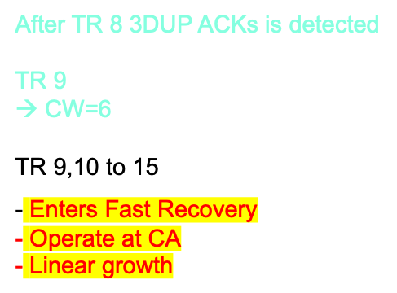
TCP: Fast Recovery
(Loss because of 3 Duplicate ACK)
TCP Fast Recovery
TR | CW | SS | ssthresh
8 | 12 | 56 | 12 / 2 = 6
TR | CW | SS | ssthresh
9 | 9 | 65 | 6
10 | 10 | 75 | 6
11 | 11 | 86 | 6
12 | 12 | 98 | 6
13 | 13 | 111 | 6
14 | 14 | 125 | 6
15 | 15 | 140 | 6
TR = Transmission Round
CW = Congestion Window
SS = Segment Send
ssthreshold = Slow Start Threshold
TCP RENO

Slide 169
TCP: detecting, reacting to loss
TCP RENO
TCP TAHOE
loss indicated by timeout: (Slow Start)
  cwnd set to 1 MSS;
  window then grows exponentially (as in slow start) to threshold, then grows linearly
loss indicated by timeout or 3 duplicate ACKs : (Slow Start)
  cwnd set to 1 MSS;
  window then grows exponentially (as in slow start) to threshold, then grows linearly
loss indicated by 3 duplicate ACKs (Fast Recovery)
  dup ACKs indicate network capable of delivering some segments
  cwnd is cut in half window plus 3 times the segment then grows linearly

Slide 170
Initial threshold = 6
Timeout @ TR 8
Self-Test
TR | CW | SS
1
2
3
4
5
6
7
8
9
10
11
12
13
14
Question:
Supposed host A connected to host B for transmitting segments over TCP with congestion control.
Assume that the initial threshold is 6 MSS.
If the timeout event occurred at transmission round (TR=8), answer the following questions:
Note: CW (Congestion Window), SS (Segment Send)

Slide 171
Initial threshold = 6
Timeout @ TR 8
Self-Test
TR | CW | SS
1
2
3
4
5
6
7
8
9
10
11
12
13
14
…
Complete the table.
What is the new threshold after timeout?
What is the range of TRs involved in the congestion avoidance.
What is the range of TRs involved in the fast recovery?
At which TR the new threshold applied and how many segments sent at that TR?
Note: CW (Congestion Window), SS (Segment Send)

Slide 172
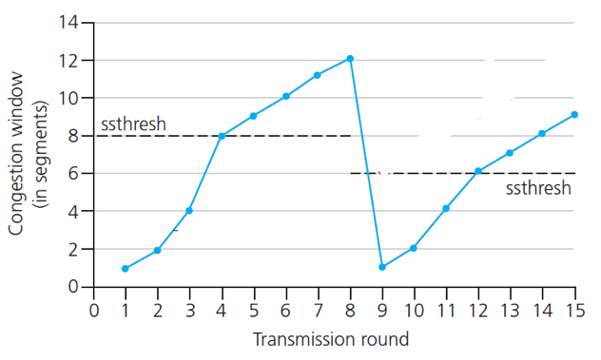
Initial threshold = 6
Timeout @ TR 8
Self-Test
TR | CW | SS
1 | 1 | 1
2 | 2 | 3
3 | 4 | 7
4 | 6 | 13
5 | 7 | 20
6 | 8 | 28
7 | 9 | 37
8 | 10 | 47
9 | 1 | 48
10 | 2 | 50
11 | 4 | 54
12 | 5 | 59
13 | 6 | 65
14 | 7 | 72
Solution:
Complete the table.
What is the new threshold after timeout?
  = 10 / 2 = 5
What is the range of TRs involved in the congestion avoidance.
  = 5 to 8, 13 to 14
threshold1
threshold2
Note: CW (Congestion Window), SS (Segment Send)

Slide 173
Initial threshold = 6
Timeout @ TR 8
Self-Test
TR | CW | SS
1 | 1 | 1
2 | 2 | 3
3 | 4 | 7
4 | 6 | 13
5 | 7 | 20
6 | 8 | 28
7 | 9 | 37
8 | 10 | 47
9 | 1 | 48
10 | 2 | 50
11 | 4 | 54
12 | 5 | 59
13 | 6 | 65
14 | 7 | 72
Solution:
What is the range of TRs involved in the fast recovery?
  = none. Loss because of timeout only
At which TR the new threshold applied and how many segments sent at that TR?
  TR = 12;
  Segment sent = 59
threshold1
threshold2
Note: CW (Congestion Window), SS (Segment Send)

Slide 174
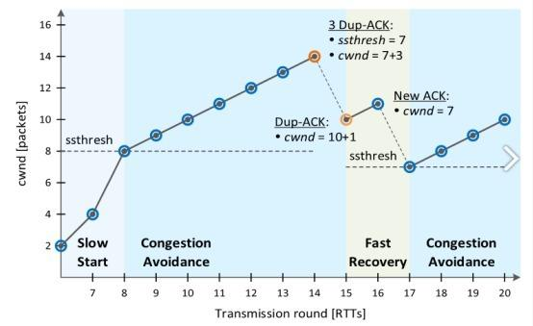
In Fast Recovery,
loss due to 3 Duplicae ACKs will set
ssthresh=1/2cwnd
cwnd = ssthresh+3
If received one more Duplicate ACKs, cwnd increase by 1
until it received the New ACK (received the missing packet), the cwnd just direct set to ssthresh

Slide 175
TCP CUBIC
Is there a better way than AIMD to “probe” for usable bandwidth?
Insight/intuition:
  W_{max}: sending rate at which congestion loss was detected
  congestion state of bottleneck link probably (?) hasn’t changed much
  after cutting rate/window in half on loss, initially ramp to to W_{max} faster, but then approach W_{max} more slowly
W_{max}
classic TCP
TCP CUBIC - higher throughput in this example
W_{max}/2

Slide 176
TCP CUBIC
K: point in time when TCP window size will reach W_{max}
  K itself is tuneable
increase W as a function of the cube of the distance between current time and K
  larger increases when further away from K
  smaller increases (cautious) when nearer K
TCP CUBIC default in Linux, most popular TCP for popular Web servers
W_{max}
TCP Reno
TCP CUBIC
TCP
sending
rate
time
t₀
t₁
t₂
t₃
t₄

Slide 177
TCP and the congested “bottleneck link”
TCP (classic, CUBIC) increase TCP’s sending rate until packet loss occurs at some router’s output: the bottleneck link
source
destination
application
TCP
network
link
physical
application
TCP
network
link
physical
packet queue almost never empty, sometimes overflows packet (loss)
bottleneck link (almost always busy)

Slide 178
TCP and the congested “bottleneck link”
TCP (classic, CUBIC) increase TCP’s sending rate until packet loss occurs at some router’s output: the bottleneck link
understanding congestion: useful to focus on congested bottleneck link
insight: increasing TCP sending rate will not increase end-end throughout with congested bottleneck
source
destination
application
TCP
network
link
physical
application
TCP
network
link
physical
insight: increasing TCP sending rate will increase measured RTT
Goal: “keep the end-end pipe just full, but not fuller”
RTT

Slide 179
Delay-based TCP congestion control
Keeping sender-to-receiver pipe “just full enough, but not fuller”: keep bottleneck link busy transmitting, but avoid high delays/buffering
# bytes sent in last RTT interval
RTT_{measured}
measured
throughput
=
RTT_{measured}
Delay-based approach:
RTT_{min} - minimum observed RTT (uncongested path)
uncongested throughput with congestion window cwnd is cwnd/RTT_{min}
if measured throughput “very close” to uncongested throughput
increase cwnd linearly /* since path not congested */
else if measured throughput “far below” uncongested throughout
decrease cwnd linearly /* since path is congested */

Slide 180
Delay-based TCP congestion control
congestion control without inducing/forcing loss
maximizing throughout (“keeping the just pipe full… ”) while keeping delay low (“…but not fuller”)
a number of deployed TCPs take a delay-based approach
  TCP BBR deployed on Google’s (internal) backbone network

Slide 181
Explicit congestion notification (ECN)
TCP deployments often implement network-assisted congestion control:
two bits in IP header (ToS field) marked by network router to indicate congestion
  policy to determine marking chosen by network operator
congestion indication carried to destination
destination sets ECE bit on ACK segment to notify sender of congestion
involves both IP (IP header ECN bit marking) and TCP (TCP header C,E bit marking)
source
TCP ACK segment
destination
application
TCP
network
link
physical
application
TCP
network
link
physical
ECE=1
ECN=10
ECN=11
IP datagram

Slide 182
TCP fairness
Fairness goal: if K TCP sessions share same bottleneck link of bandwidth R, each should have average rate of R/K
TCP connection 1
bottleneck
router
capacity R
TCP connection 2

Slide 183
Q: is TCP Fair?
Example: two competing TCP sessions:
additive increase gives slope of 1, as throughout increases
multiplicative decrease decreases throughput proportionally
R
equal bandwidth share
Is TCP fair?
A: Yes, under idealized assumptions:
same RTT
fixed number of sessions only in congestion avoidance
loss: decrease window by factor of 2
congestion avoidance: additive increase
Connection 2 throughput
loss: decrease window by factor of 2
congestion avoidance: additive increase
Connection 1 throughput
R

Slide 184
Fairness: must all network apps be “fair”?
Fairness and UDP
multimedia apps often do not use TCP
  do not want rate throttled by congestion control
instead use UDP:
  send audio/video at constant rate, tolerate packet loss
there is no “Internet police” policing use of congestion control
Fairness, parallel TCP connections
application can open multiple parallel connections between two hosts
web browsers do this , e.g., link of rate R with 9 existing connections:
  new app asks for 1 TCP, gets rate R/10
  new app asks for 11 TCPs, gets R/2

Slide 185
Transport layer: roadmap
Transport-layer services
Multiplexing and demultiplexing
Connectionless transport: UDP
Principles of reliable data transfer
Connection-oriented transport: TCP
Principles of congestion control
TCP congestion control
Evolution of transport-layer functionality
Notes:
Not in Slide V7

Slide 186
Evolving transport-layer functionality
TCP, UDP: principal transport protocols for 40 years
different “flavors” of TCP developed, for specific scenarios:
Scenario | Challenges
Long, fat pipes (large data transfers) | Many packets “in flight”; loss shuts down pipeline
Wireless networks | Loss due to noisy wireless links, mobility; TCP treat this as congestion loss
Long-delay links | Extremely long RTTs
Data center networks | Latency sensitive
Background traffic flows | Low priority, “background” TCP flows
moving transport–layer functions to application layer, on top of UDP
  HTTP/3: QUIC

Slide 187
QUIC: Quick UDP Internet Connections
application-layer protocol, on top of UDP
  increase performance of HTTP
  deployed on many Google servers, apps (Chrome, mobile YouTube app)
HTTP/2
HTTP/2 (slimmed)
Application
HTTP/3
TLS
QUIC
Transport
TCP
UDP
Network
IP
IP
HTTP/2 over TCP
HTTP/2 over QUIC over UDP

Slide 188
QUIC: Quick UDP Internet Connections
adopts approaches we’ve studied in this chapter for connection establishment, error control, congestion control
  error and congestion control: “Readers familiar with TCP’s loss detection and congestion control will find algorithms here that parallel well-known TCP ones.” [from QUIC specification]
  connection establishment: reliability, congestion control, authentication, encryption, state established in one RTT
multiple application-level “streams” multiplexed over single QUIC connection
  separate reliable data transfer, security
  common congestion control

Slide 189
QUIC: Connection establishment
TCP handshake
(transport layer)
QUIC handshake
data
TLS handshake
(security)
data
TCP (reliability, congestion control state) + TLS (authentication, crypto state)
2 serial handshakes
QUIC: reliability, congestion control, authentication, crypto state
1 handshake

Slide 190
QUIC: streams: parallelism, no HOL blocking
HTTP
GET
HTTP
GET
HTTP
GET
HTTP
GET
HTTP
GET
application
HTTP
GET
QUIC
encrypt
QUIC
encrypt
QUIC
encrypt
QUIC
encrypt
QUIC
encrypt
QUIC
encrypt
TLS encryption
TLS encryption
QUIC
RDT
QUIC
RDT
QUIC
RDT
QUIC
RDT
QUIC
RDT
QUIC
RDT
error!
QUIC Cong. Cont.
QUIC Cong. Cont.
TCP RDT
TCP RDT
error!
transport
TCP Cong. Contr.
TCP Cong. Contr.
UDP
UDP
(a) HTTP 1.1
(b) HTTP/2 with QUIC: no HOL blocking

Slide 191
Chapter 3: summary
principles behind transport layer services:
  multiplexing, demultiplexing
  reliable data transfer
  flow control
  congestion control
instantiation, implementation in the Internet
  UDP
  TCP
Up next:
leaving the network “edge” (application, transport layers)
into the network “core”
two network-layer chapters:
  data plane
  control plane

Slide 192
Additional Chapter 3 slides

Slide 193
TCP throughput
avg. TCP thruput as function of window size, RTT?
  ignore slow start, assume always data to send
W: window size (measured in bytes) where loss occurs
  avg. window size (# in-flight bytes) is ¾ W
  avg. thruput is 3/4W per RTT
avg TCP thruput =
3
W
4
RTT
bytes/sec
W
W/2

Slide 194
TCP Futures: TCP over “long, fat pipes”
example: 1500 byte segments, 100ms RTT, want 10 Gbps throughput
requires W = 83,333 in-flight segments
throughput in terms of segment loss probability, L [Mathis 1997]:
  ➜ to achieve 10 Gbps throughput, need a loss rate of L = 2·10⁻¹⁰ – a very small loss rate!
new versions of TCP for high-speed
1.22
.
MSS
TCP throughput =
RTT
L

